Slide 1
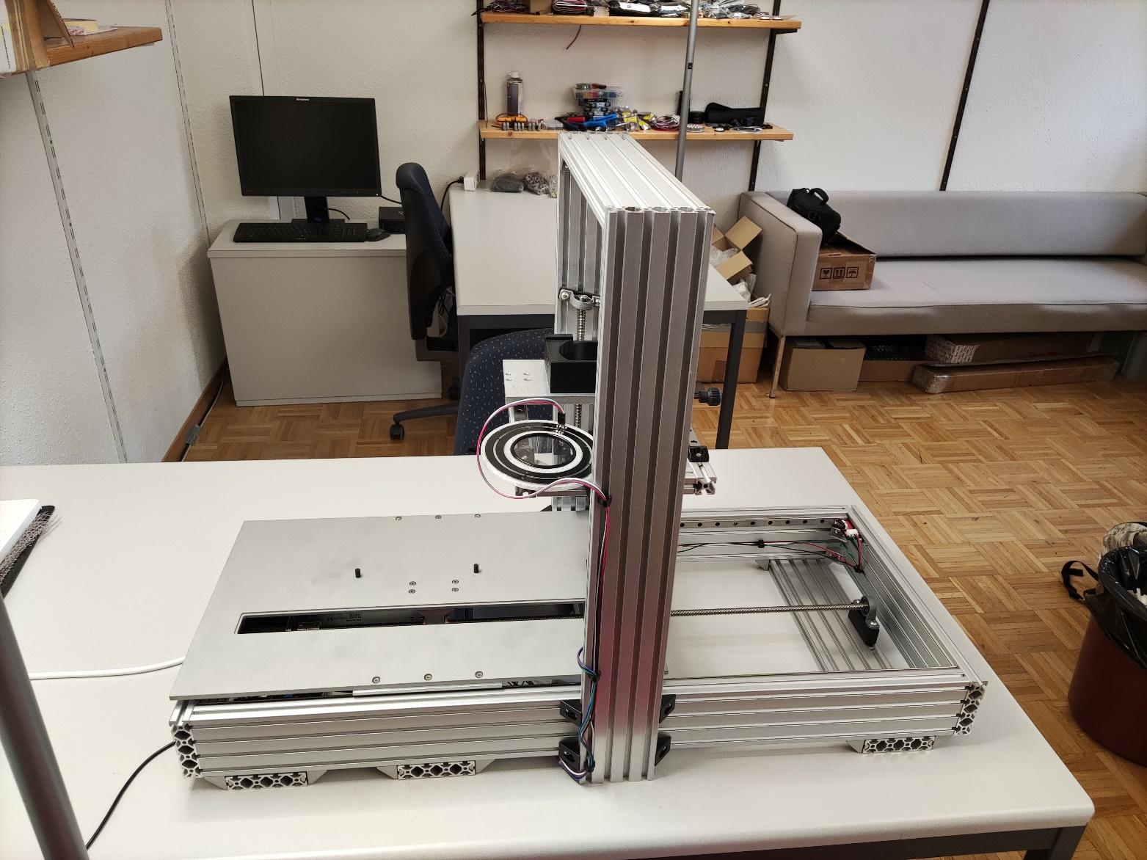
Skippy structural parts overview
16
11
10
12-15
1-4 feets (3 transverse bar for lamp)
5 & 7 back and front
6 & 8 left and right sides
9-11 camera arch
12-15 camera holder frame
16 camera plate
17 main plate
6
5
17
7
1
2
9
3
4
8

Slide 2
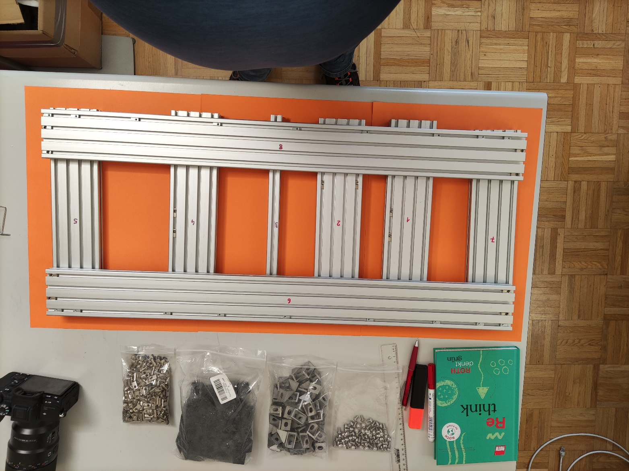
Frame components
1-4 feet elements
5+7 sidewalls
6+8 front and back

Slide 3
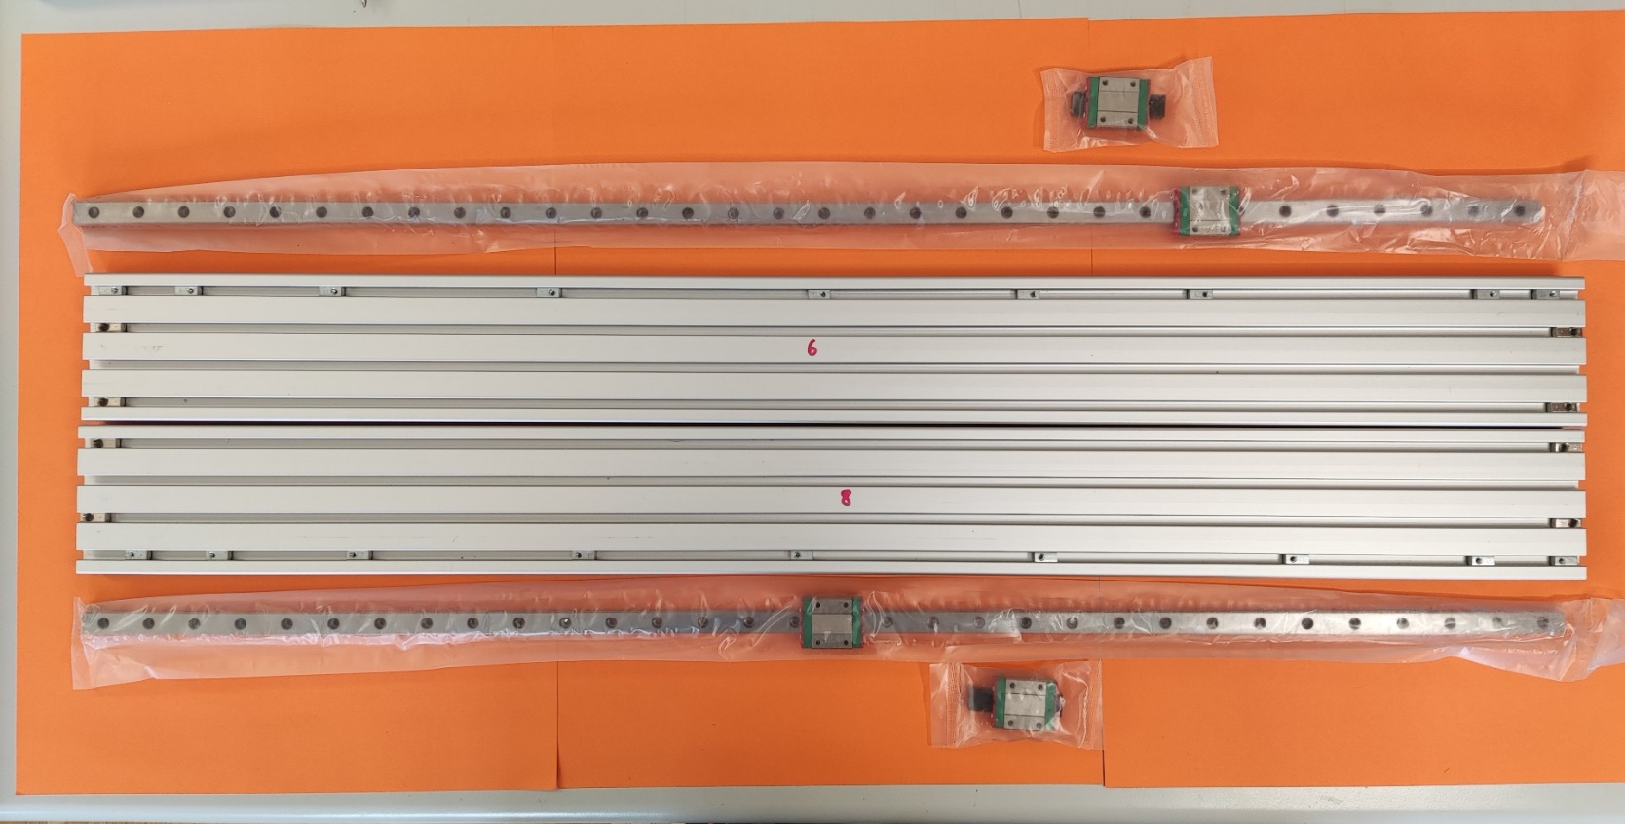
Front and back
Rails position and nuts

Slide 4
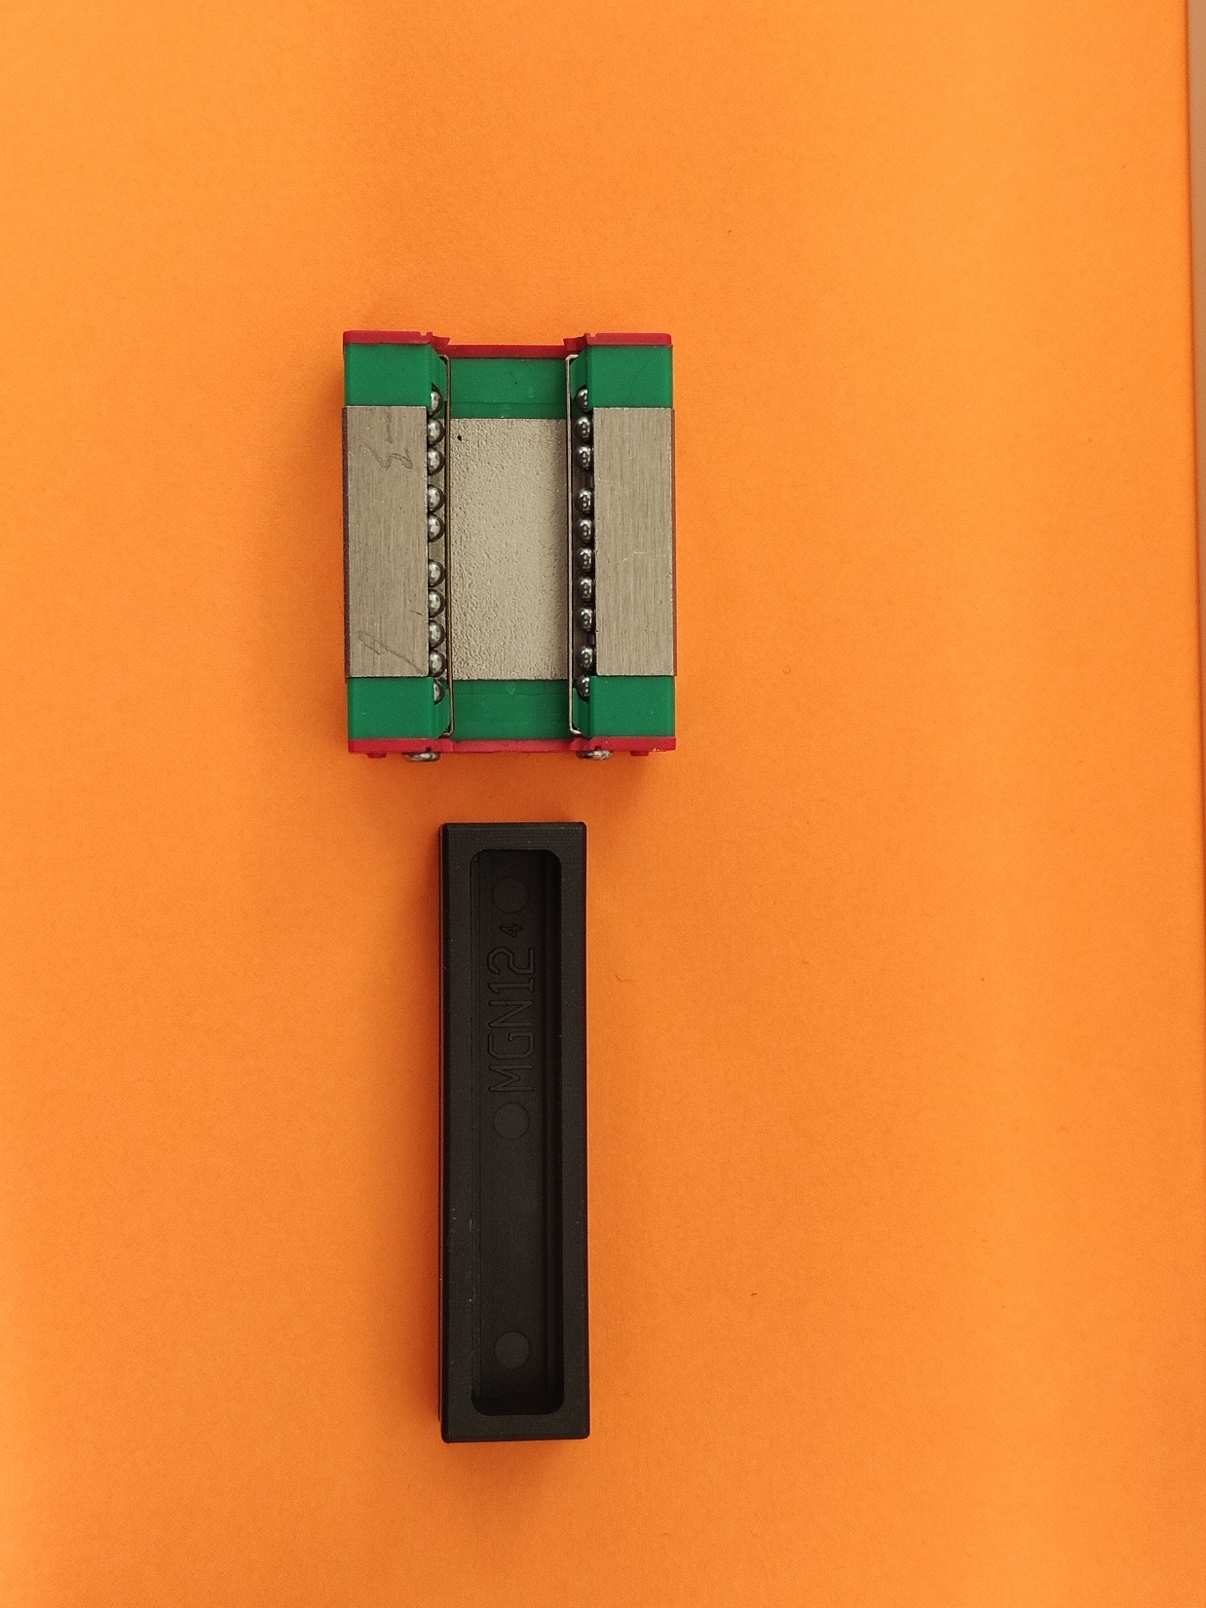
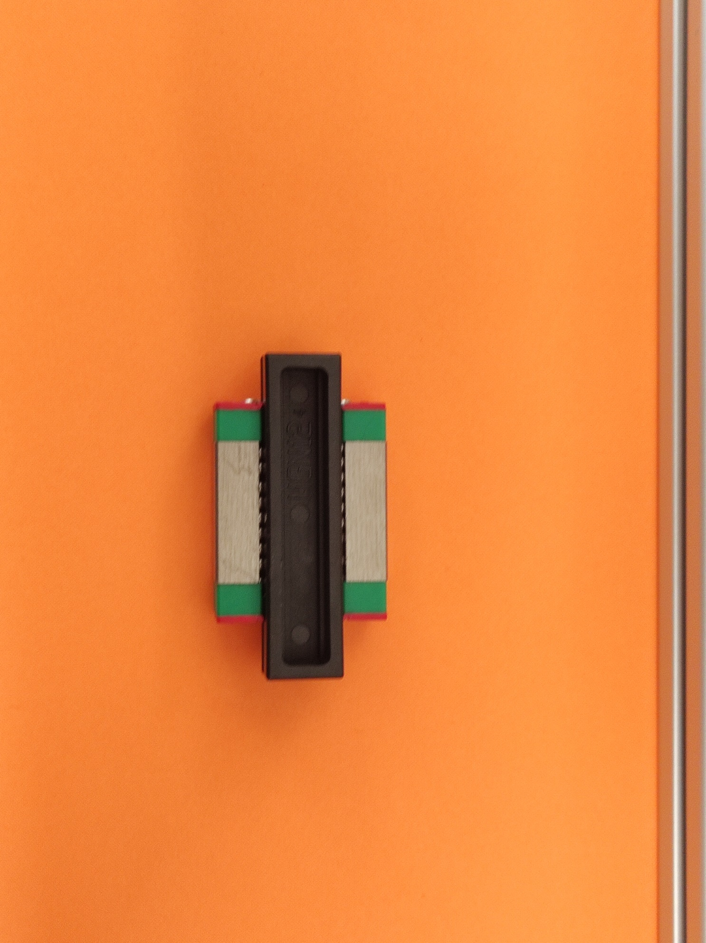
Secondary carriage
When you buy a secondary carriage they come with an additional black plastic spacer for transport. Carefully pull it out and make sure you don’t loose any ball bearings.

Slide 5
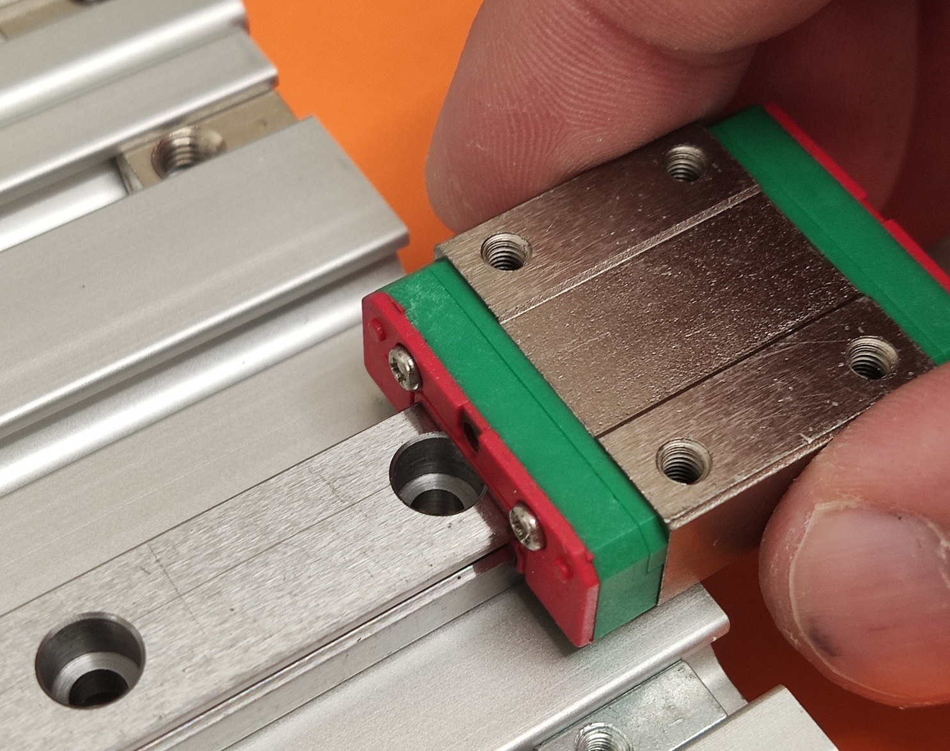
Secondary carriage
Carefully add the carriage onto the rail. Do not force! Make sure you don’t loose any ball bearing

Slide 6
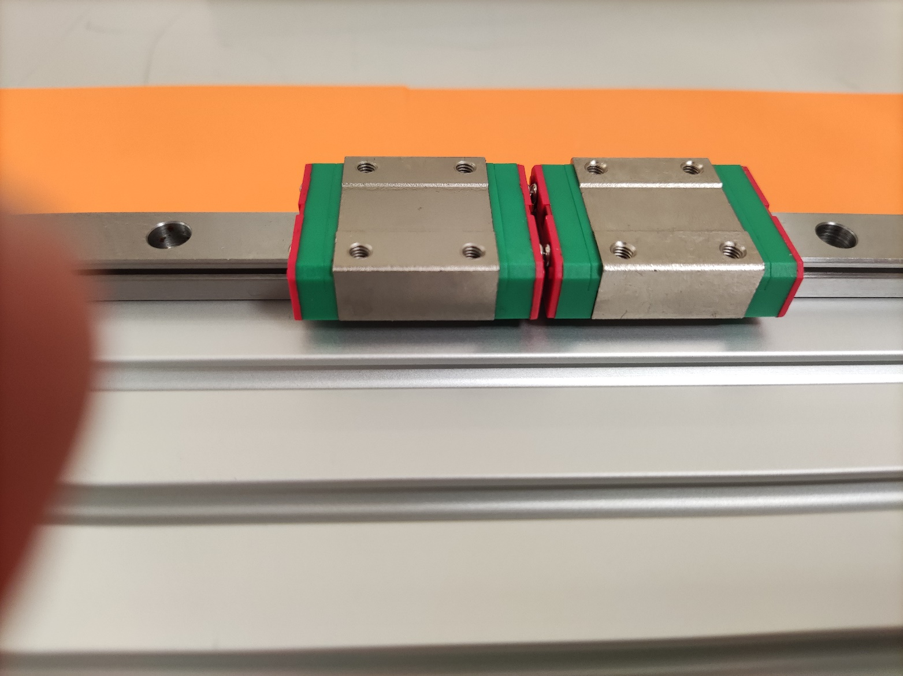
Rails
There should now be two carriages on each of the main rails

Slide 7
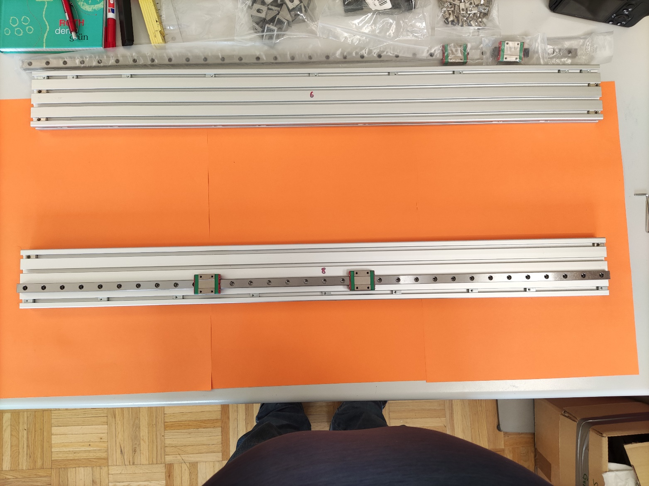
Rails
Use 9 M3*8mm screws and 9 m3 nuts to fasten the rails to the frame component as shown in picture
Do not tighten strongly the height of the rails needs to be adjusted later on
Add 2 M5 nuts on each side in the top and 3rd. Groove.
Add another 7 M5 nuts in the bottom grove (see arrow. Groove not seen in picture) these will become important later
Add 2 M5 nut in each row of groves in the back
Do this for each side

Slide 8
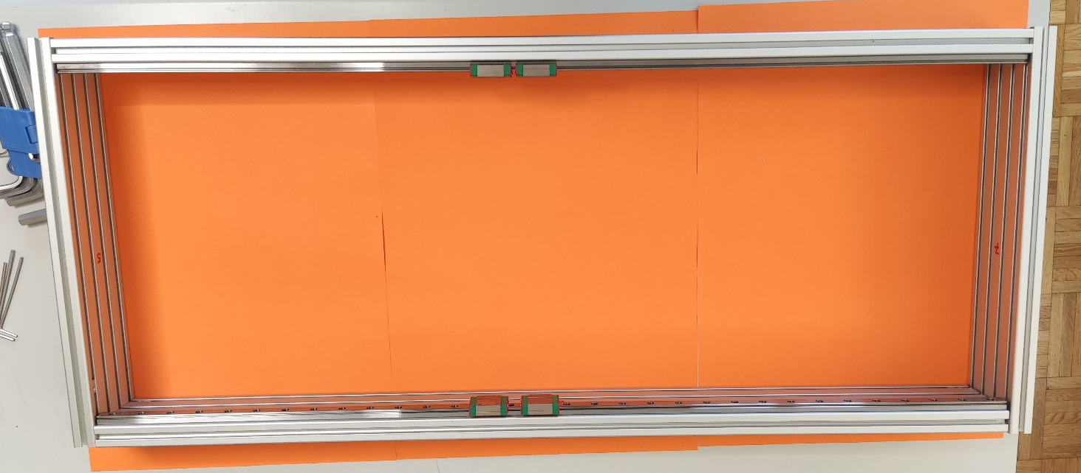
Frame
This is how all the frame part should fit together

Slide 9
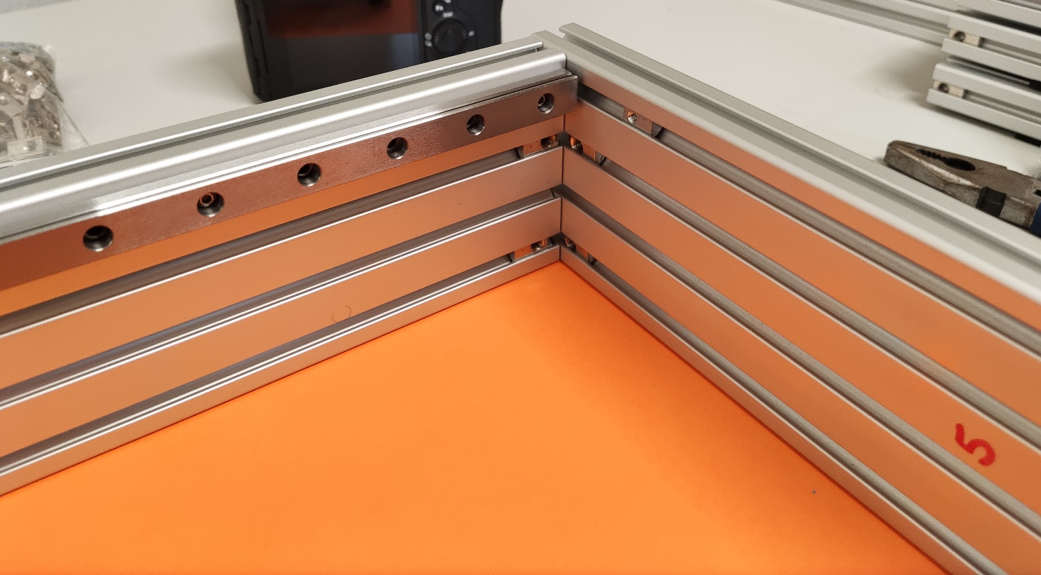
Corner
There should be 2 m5 nuts on each of the frame component where the metal corner will be screwed in
On the frame piece 5 add a m3 nut in the top rail

Slide 10
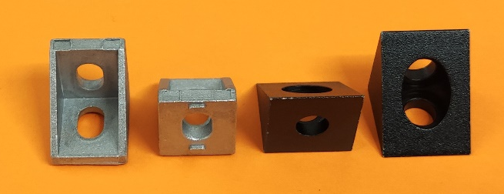
Metal corners
Please note that there are two different kind of 90° fasteners: the metalic ones have small tabs that fit into the grooves of the aluminium profiles and the black are smooth

Slide 11
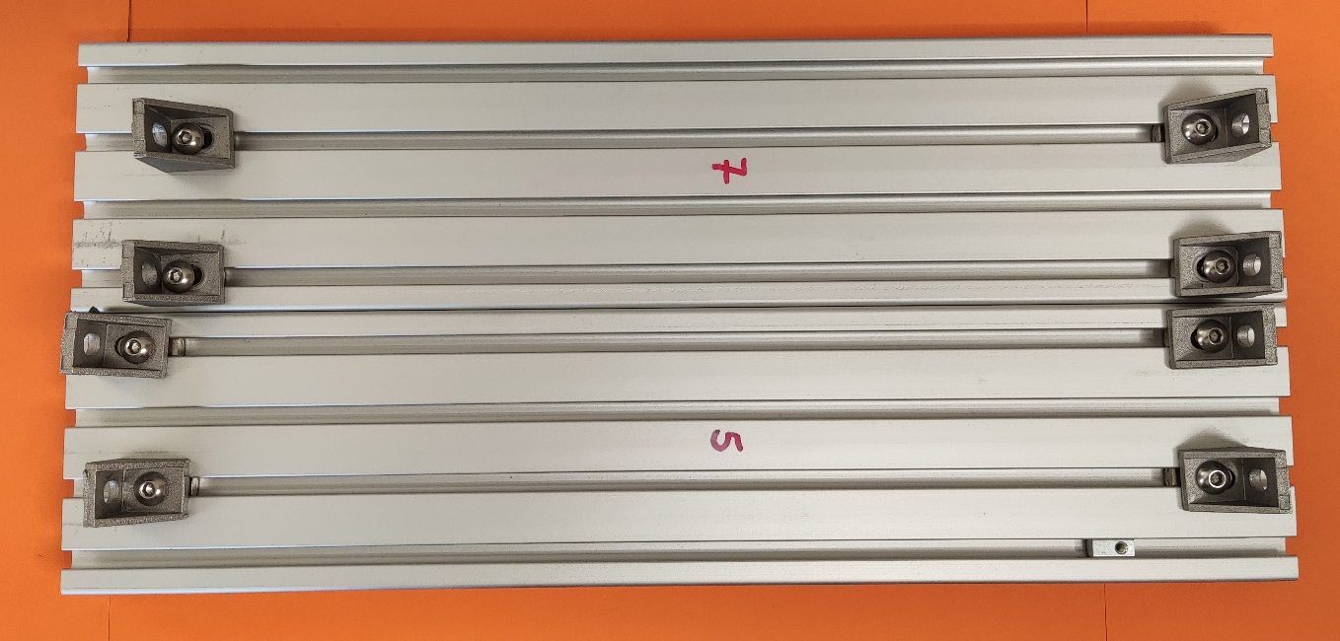
Fastener
Use M5 *8mm and metallic fasteners on frame piece 5 and 7 as shown on picture
Only mount them but do not tighten the screws so that the fasteners can still move freely

Slide 12
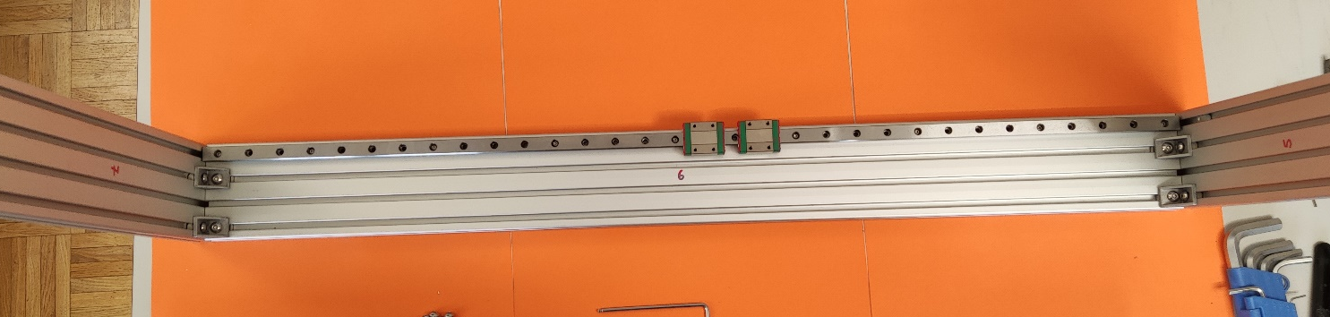
Assemble frame base
Use more M5*8mm screws to assemble frame as shown

Slide 13
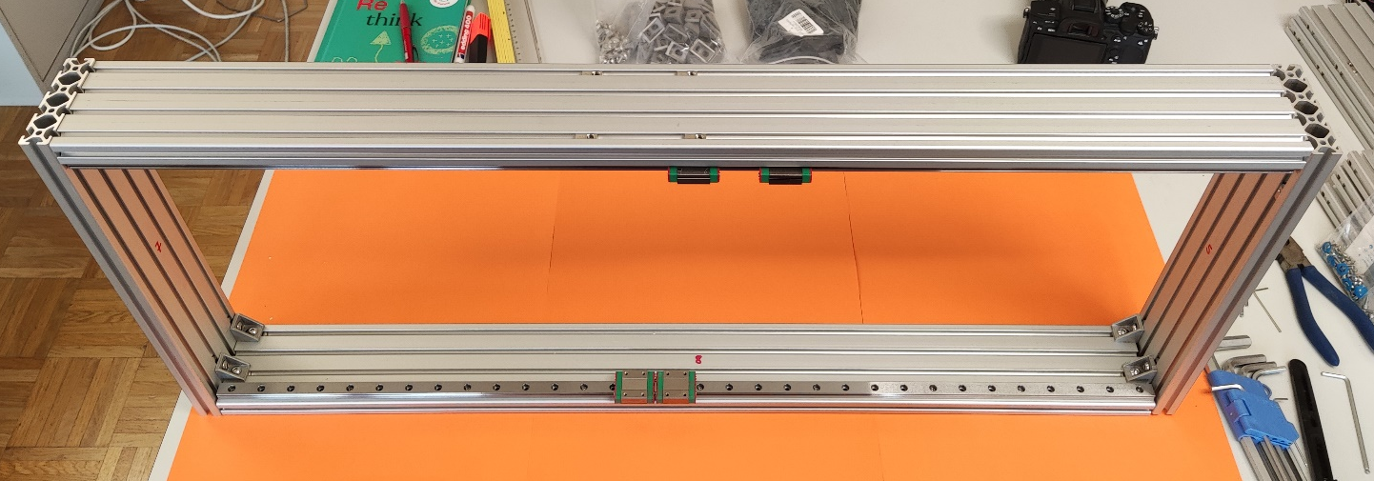
Assemble frame base
Once all elements of the frame are in place make sure the frame is flat and tighten the screws well

Slide 14
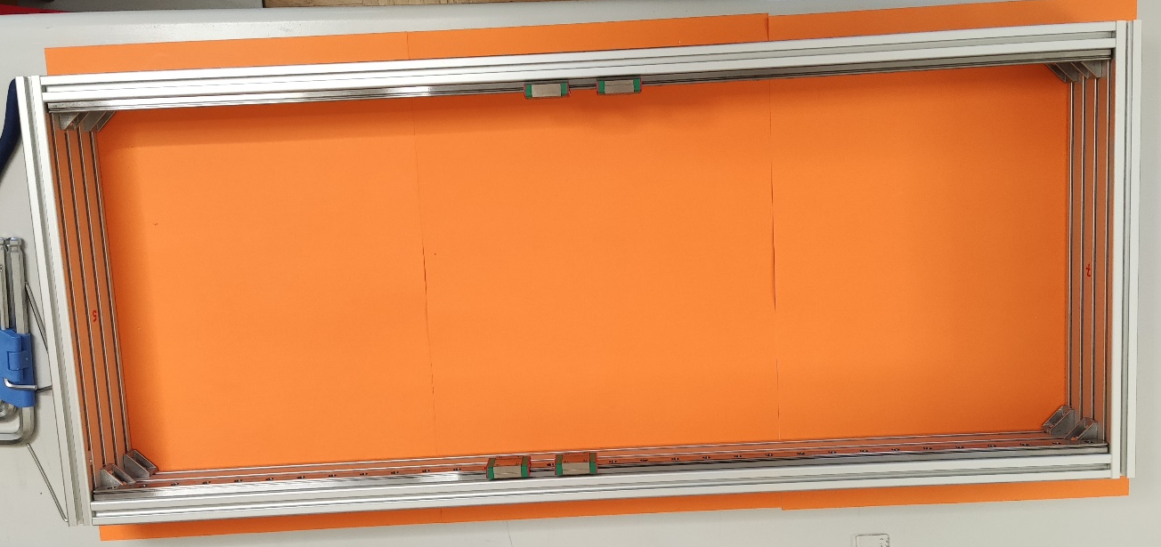
Finished frame base
This is how the frame should look from the top
Note that is should be flat and sit well on the table
If not flat loosen the screws press down on the table and tighten the screws again

Slide 15
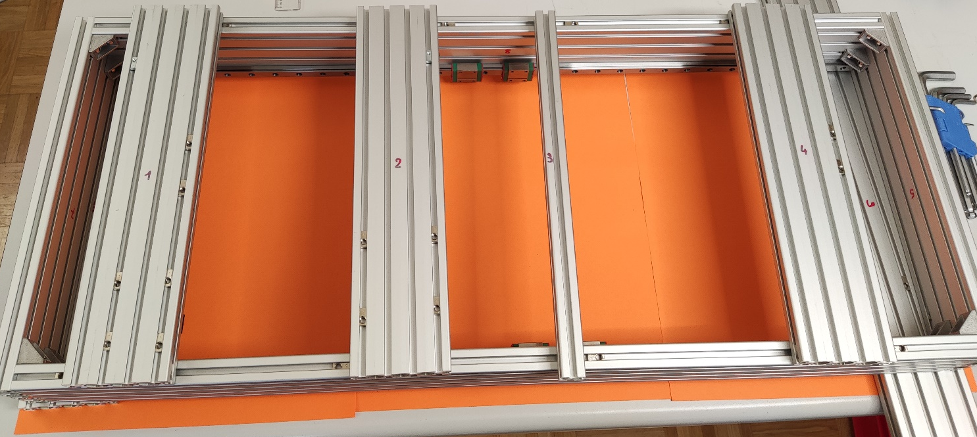
Feets
Flip the frame over so that the rails are now at the bottom
Add the feets as shown and add all the required nuts
Note that the two highlighted nuts are M3 the rest are M5
Notice the M5 nuts in the bottom grove of the sidewalls (arrows) as well as the corresponding nuts in the feet

Slide 16
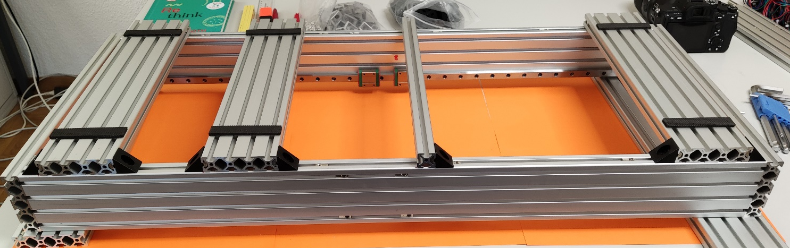
Mount feets
Flip prepared feet over and fasten to base frame with black metal corners and M5*8mm screws
Distance from left should be 4cm,21cm,44cm and 80cm respectively for the feet
Add rubberized stickers to feet as required

Slide 17
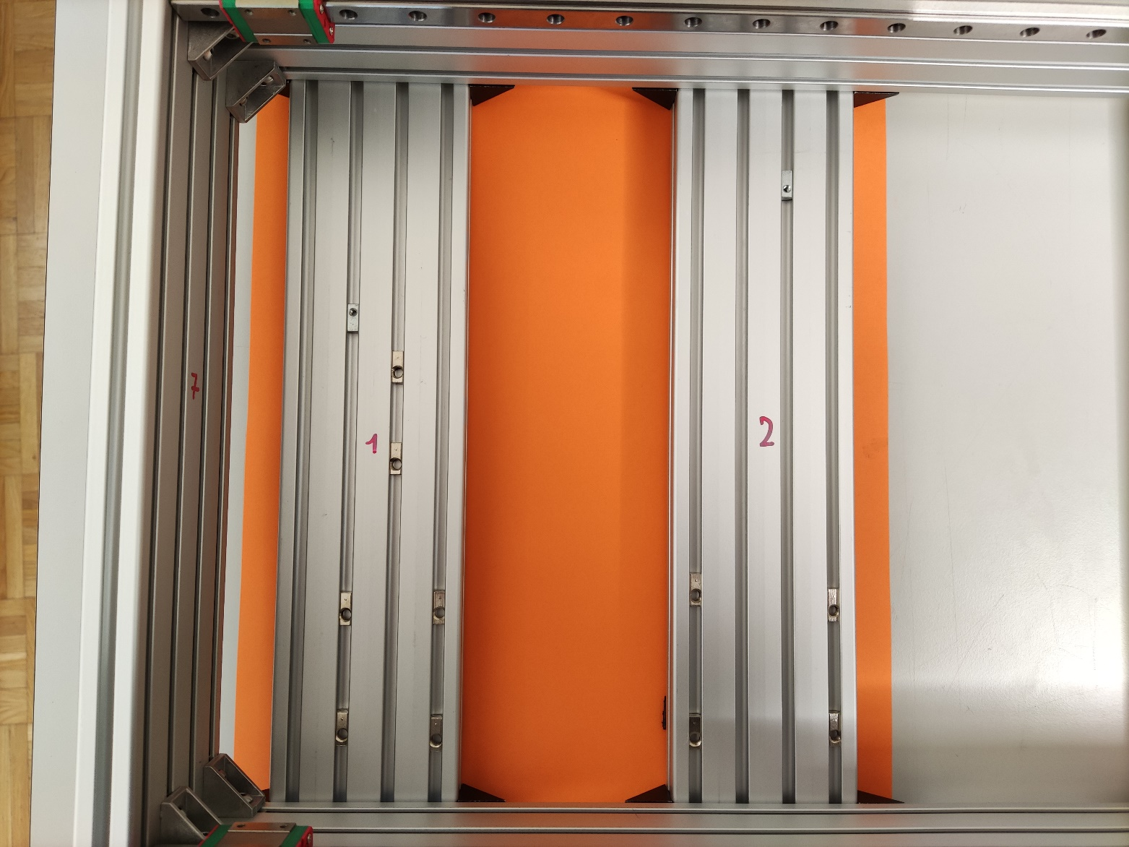
Inside Frame
Flip the frame over and this is how it should look from inside.
Insert 3d printed spacers between foot and rail for the first and last foot (arrow)
adjust rail height so that the rails rest on the spacer at the front and back and tighten
Do this for both rails

Slide 18
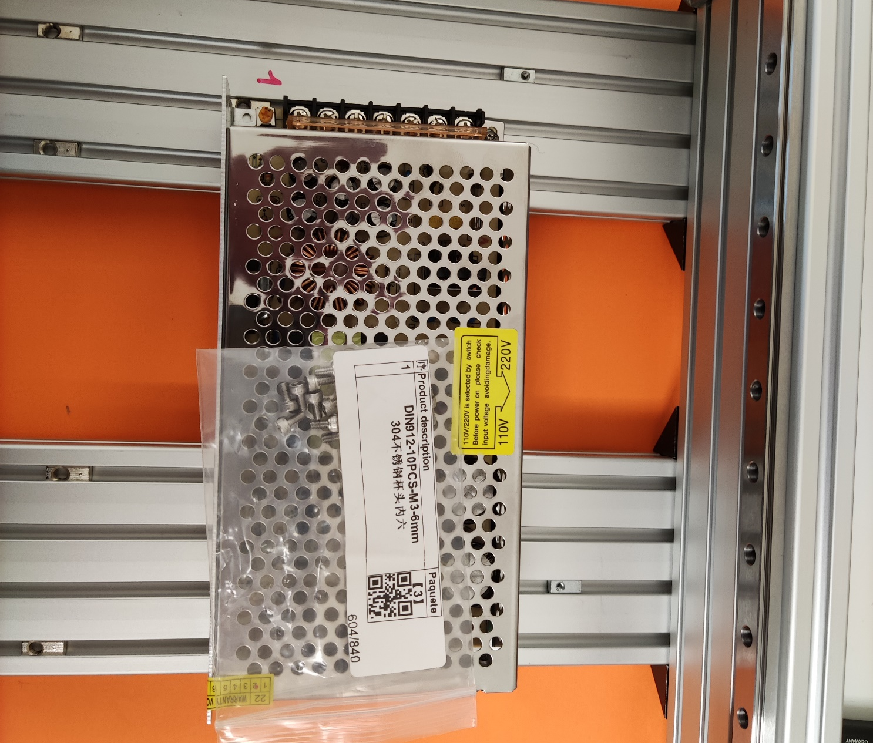
Power supply
The power supply has 2 holes for mounting

Slide 19
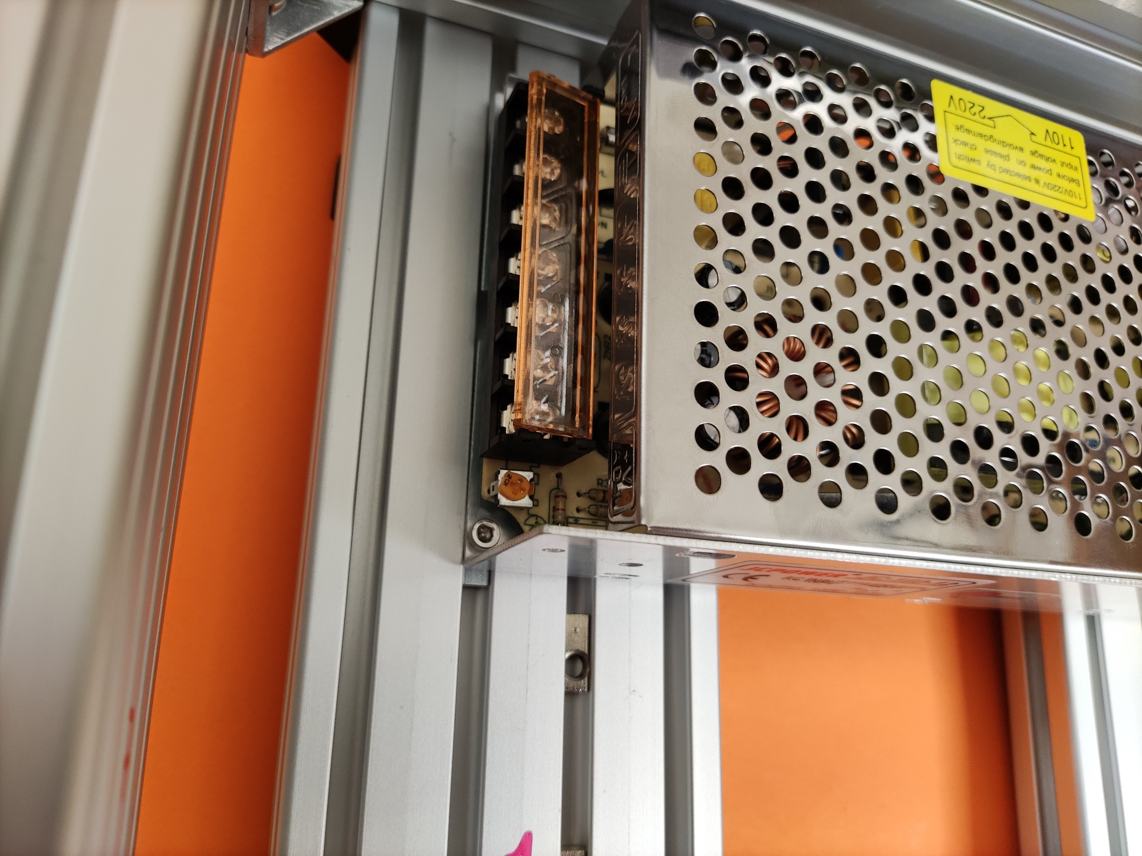
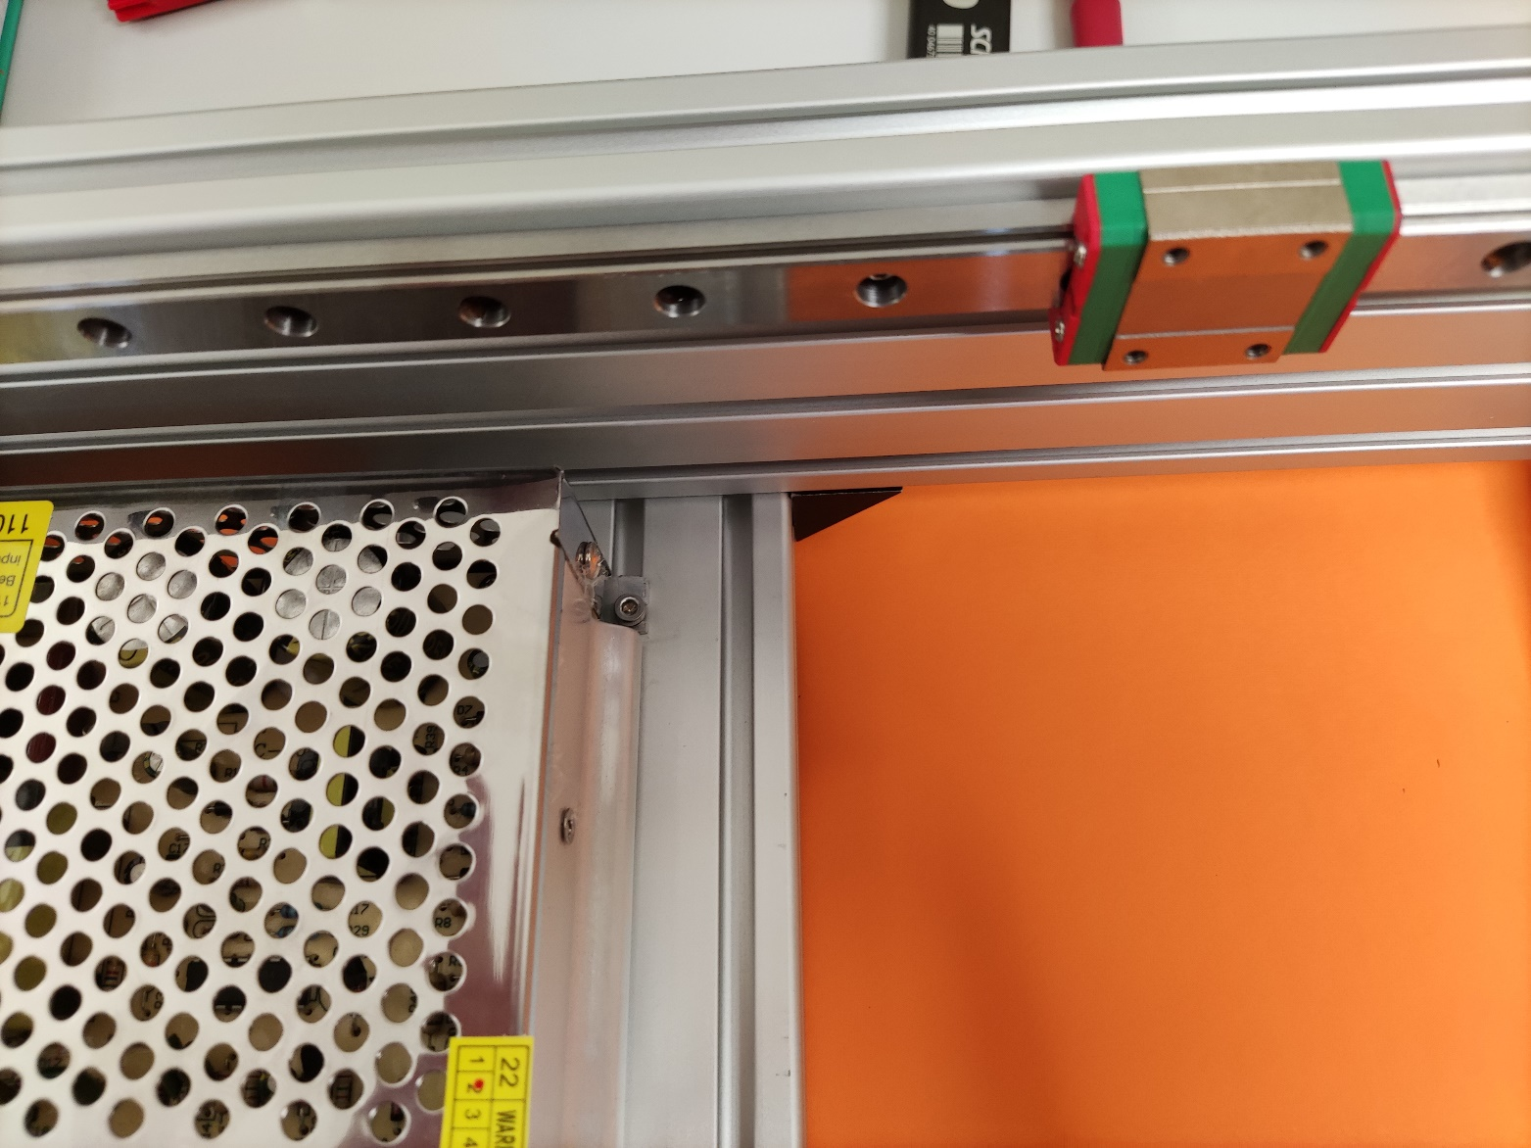
Power supply
Use 2 m3*6mm screws to secure the power supply

Slide 20
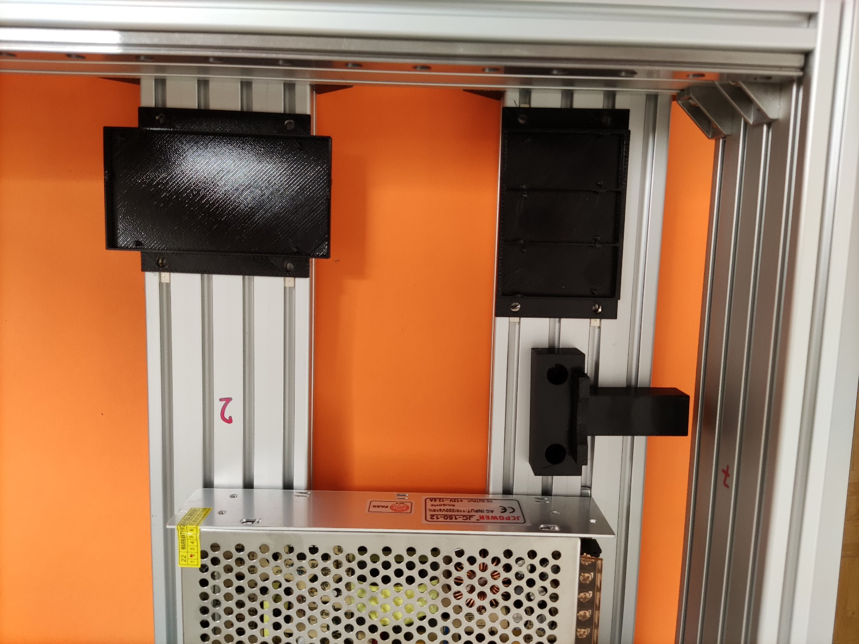
Printed parts
This is where some of the printed parts go

Slide 21
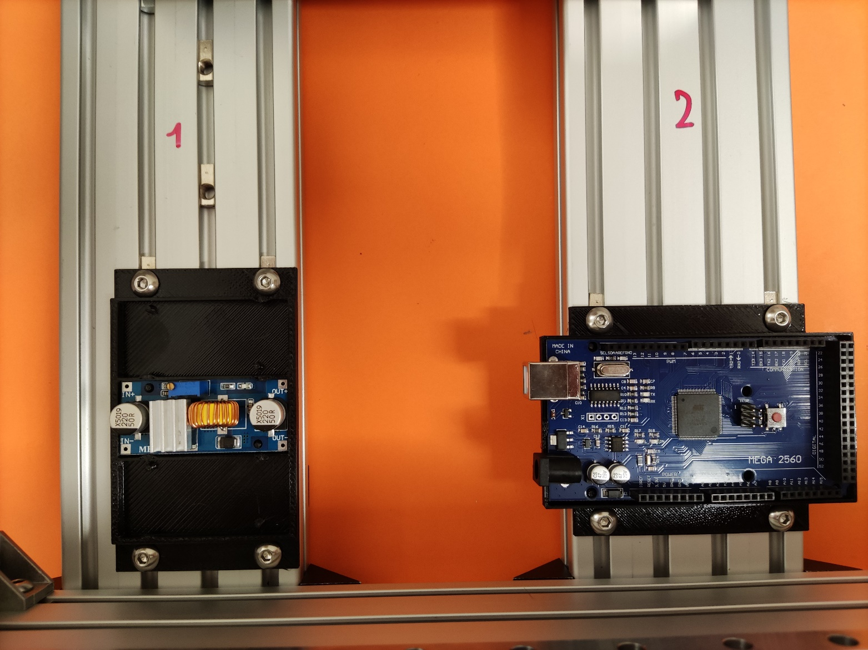
Printed parts
Secure the 3d printed holder for the power electronics and the Arduino with 4 M5*8mm screws each

Slide 22
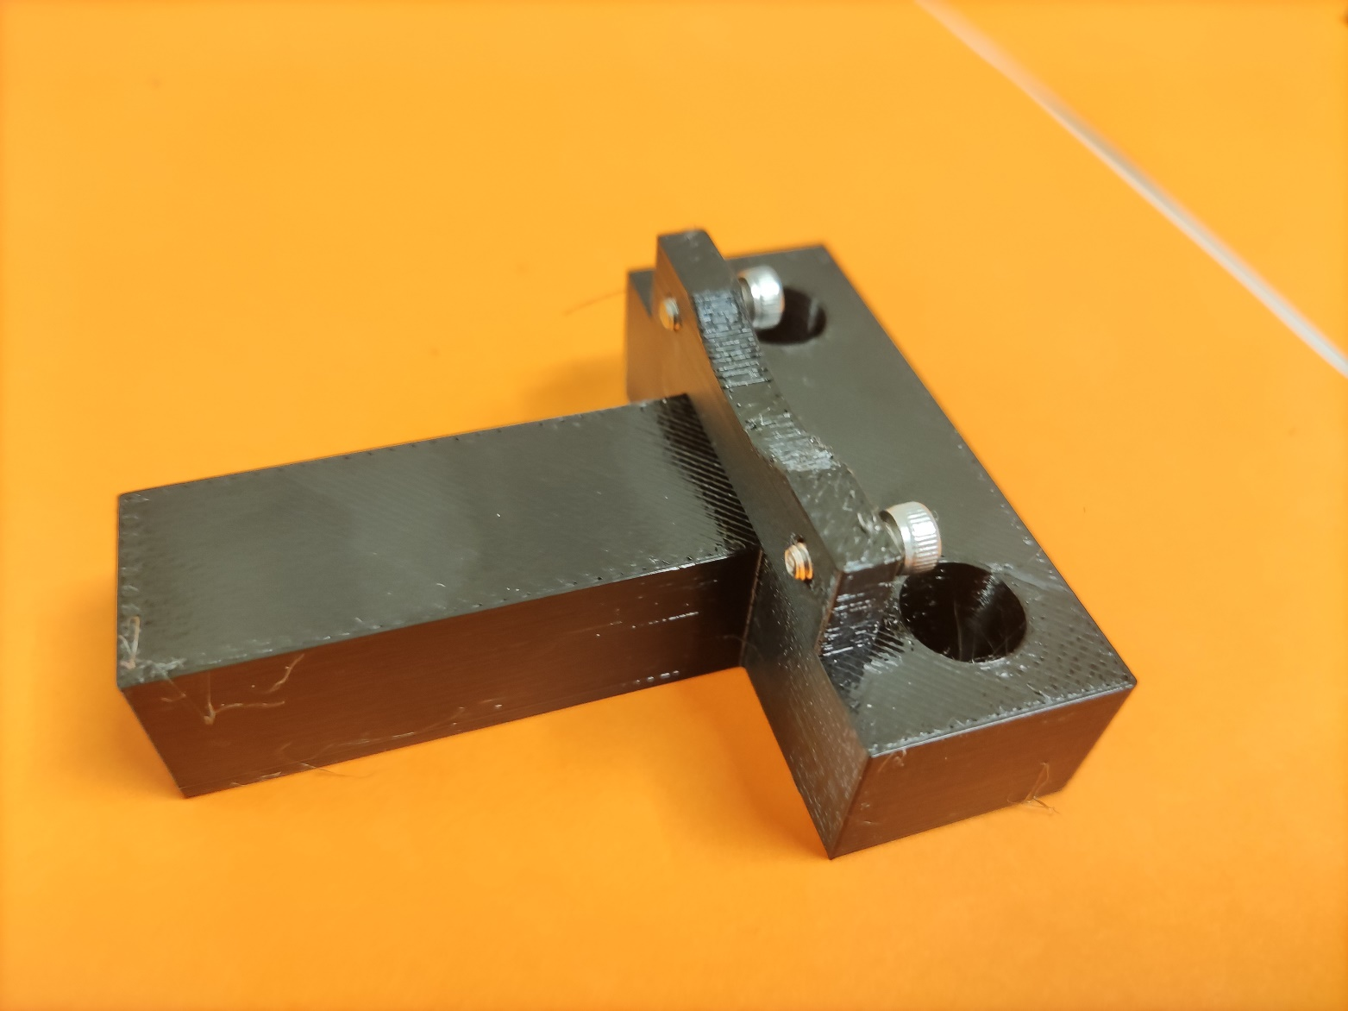
Prepare main axis
Insert/screw 2 m3*8mm screws as shown

Slide 23
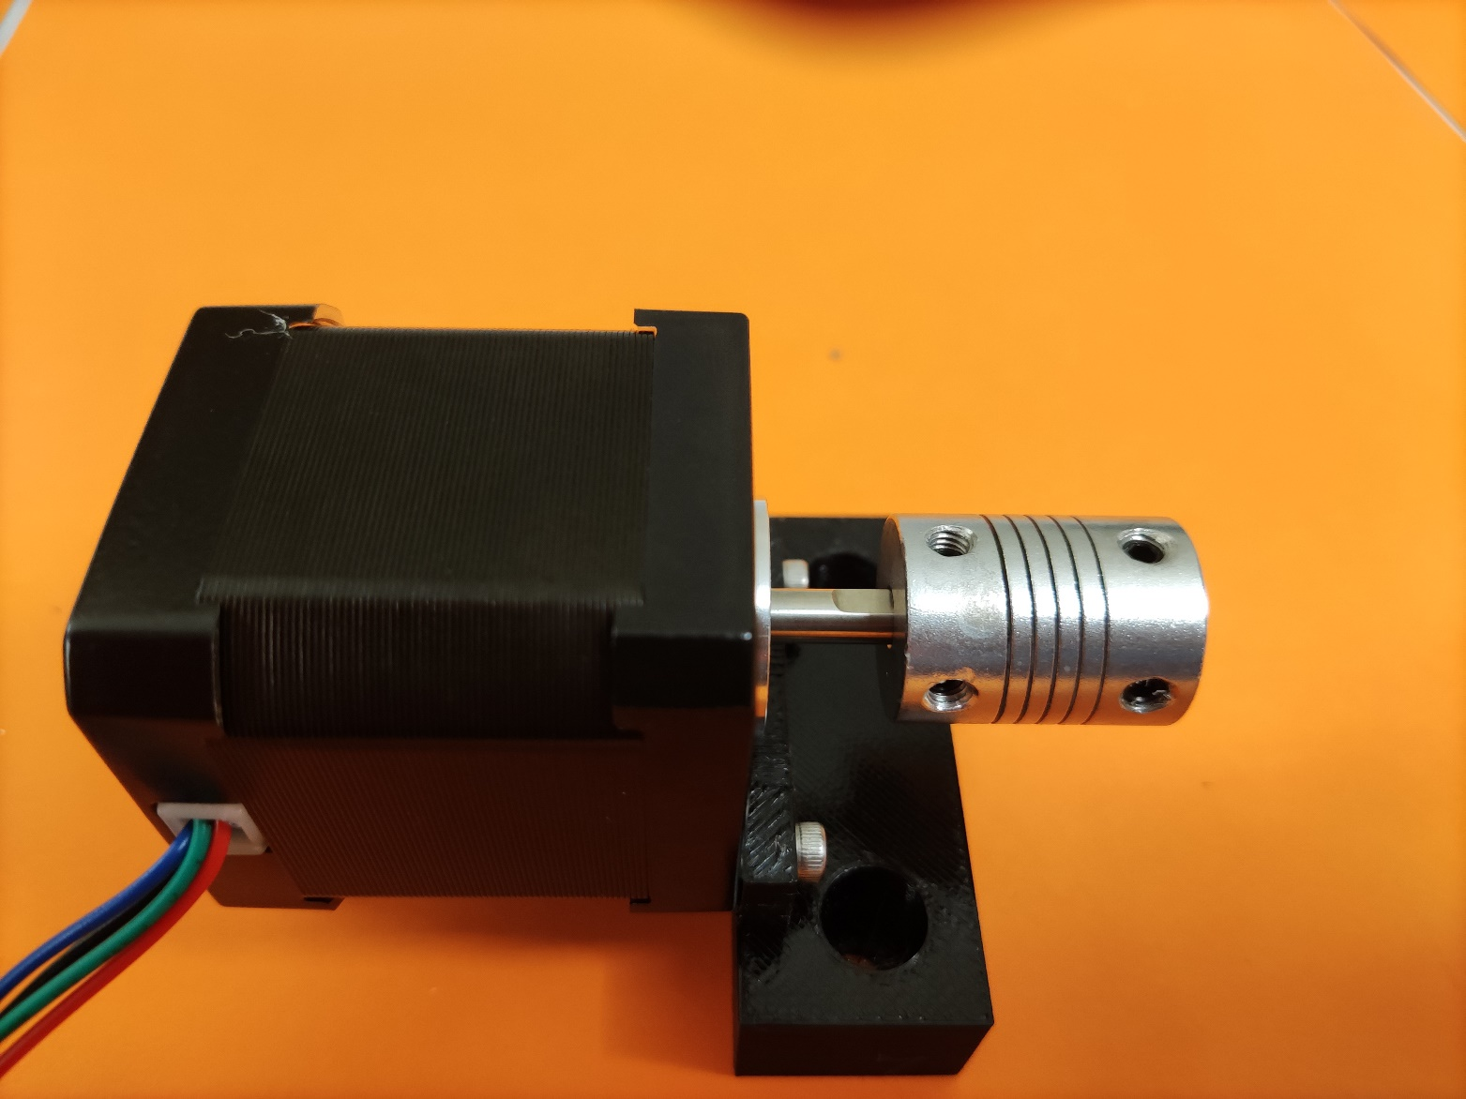
Prepare main axis
Add aluminium coupler and tighten inbus screw. Make sure one screw tightens down on the flatened end of the stepper shaft
Attach the stepper to the holder and tighten the M3 screws
Make sure the cable comes out sideways as depicted

Slide 24
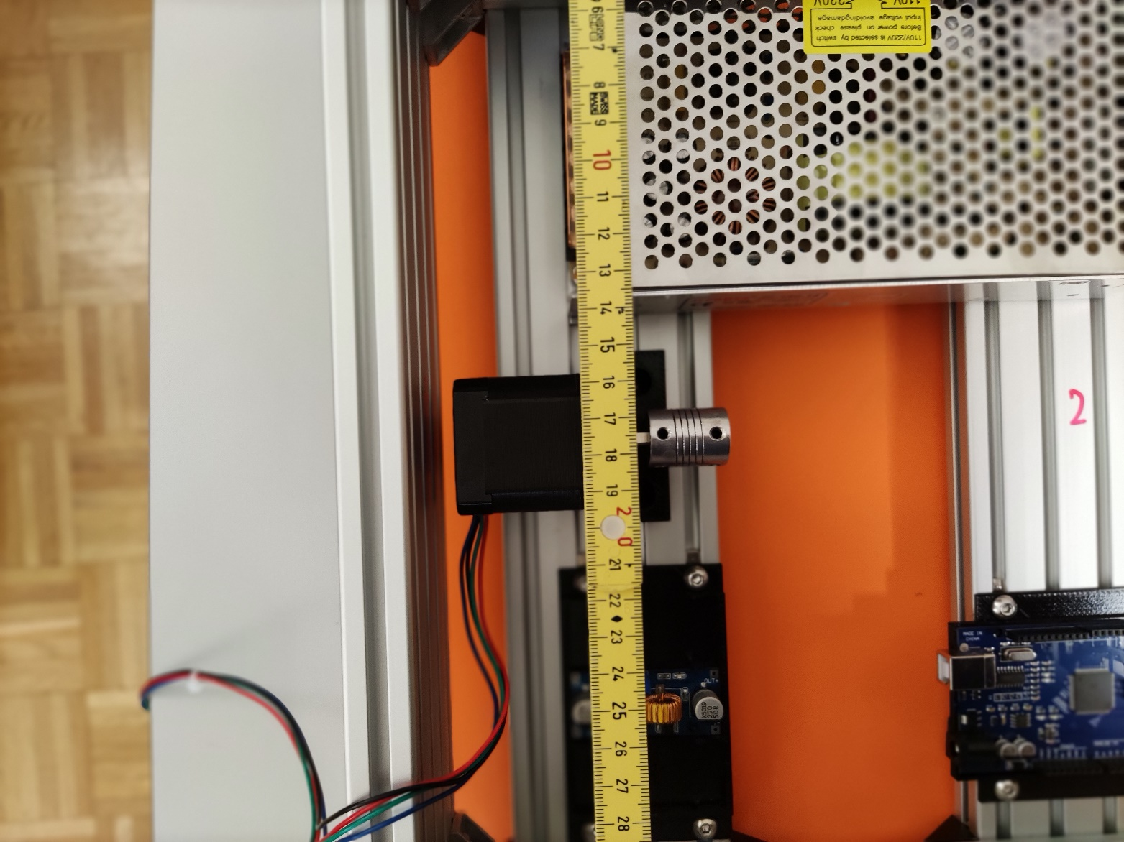
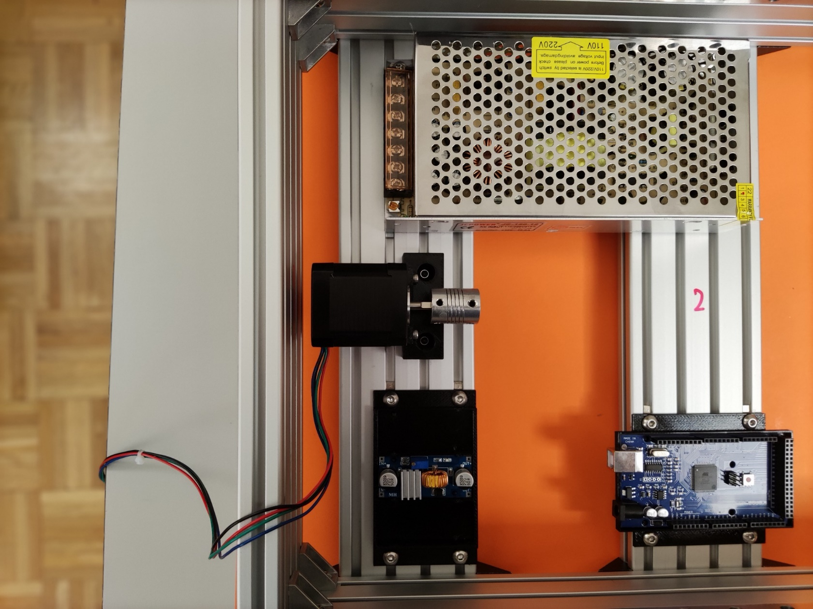
Mount main axis stepper
Make sure the holder is more or less centered (17.5 cm from border) and screw lightly down with two M5*8mm screws

Slide 25
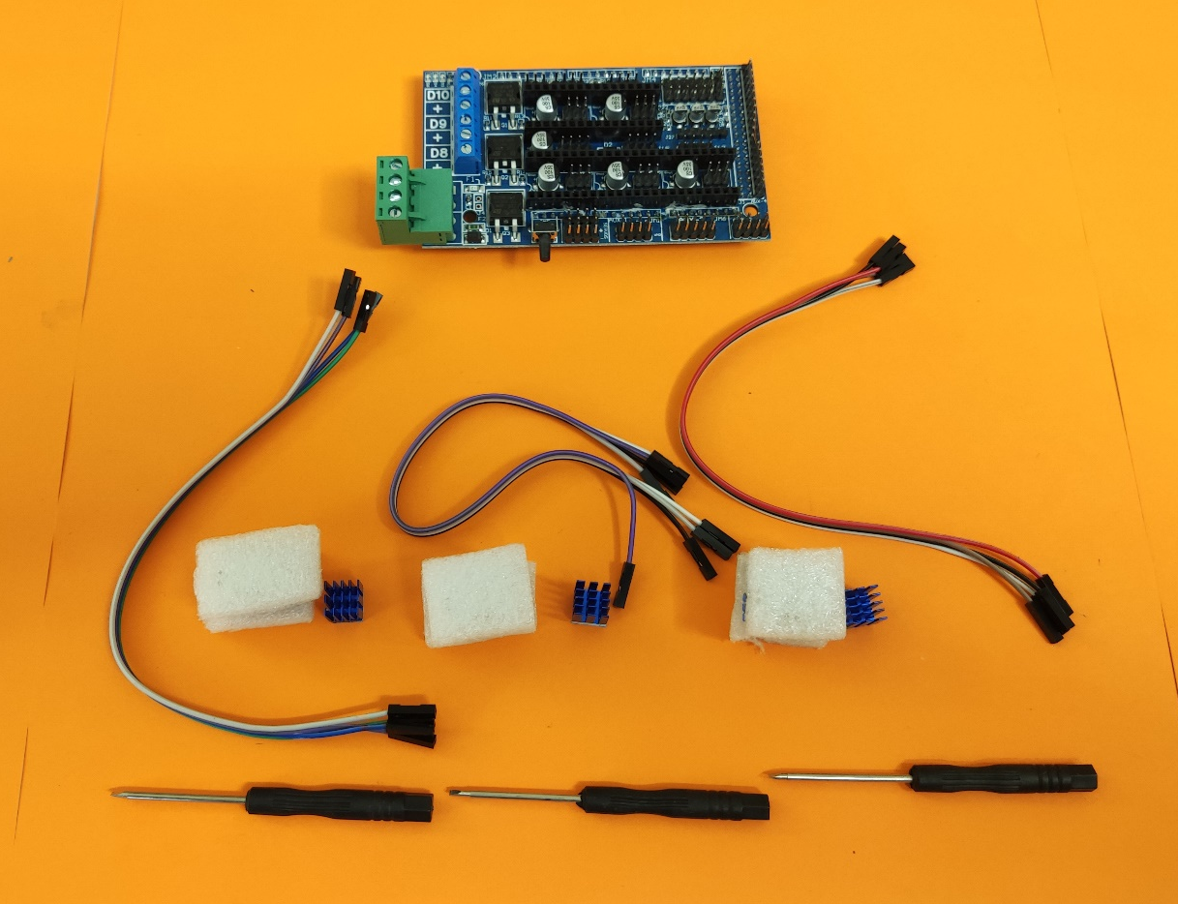
Prepare the electronics
Unpack Arduino shield and 3 driver stepper driver board

Slide 26
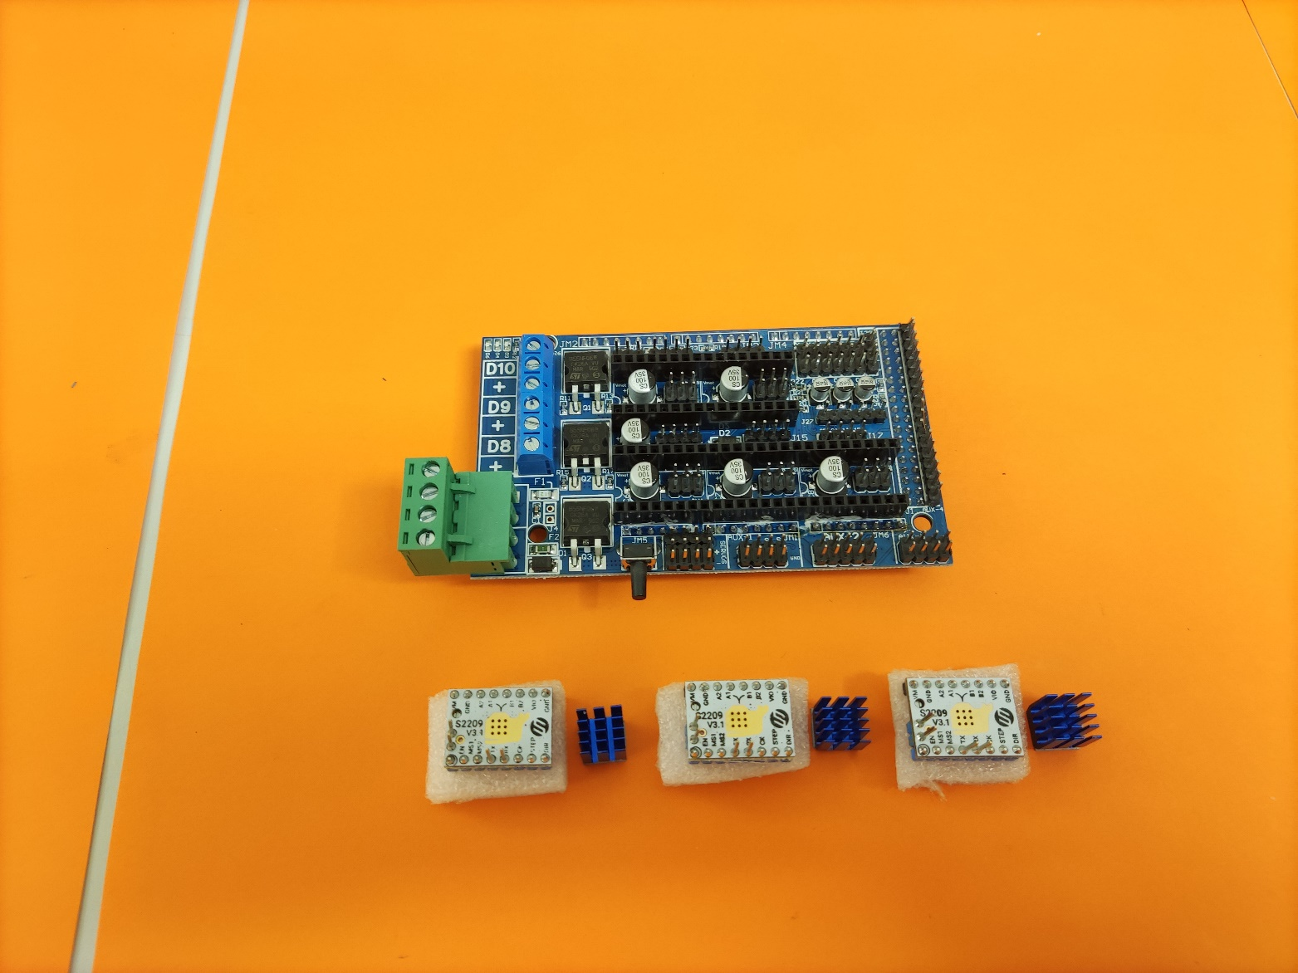
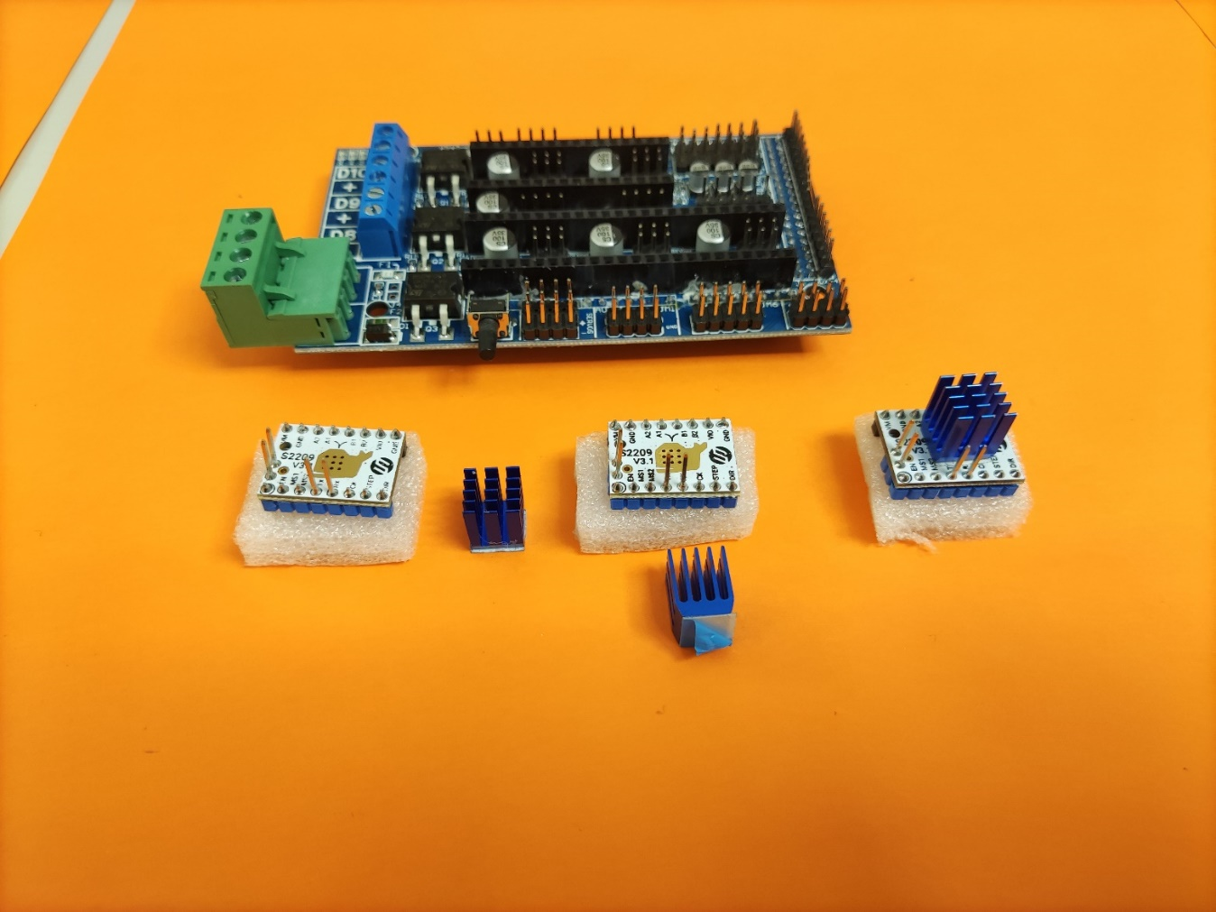
Prepare the electronic
Depending on used stepper driver stick cooler on the driver board

Slide 27
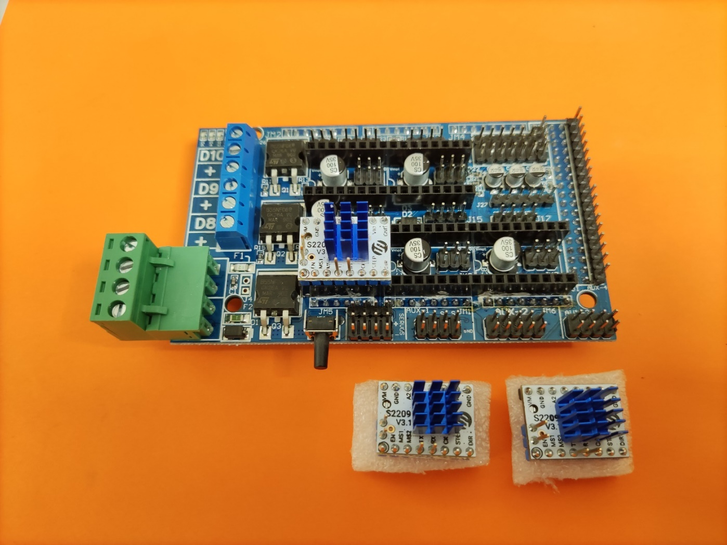
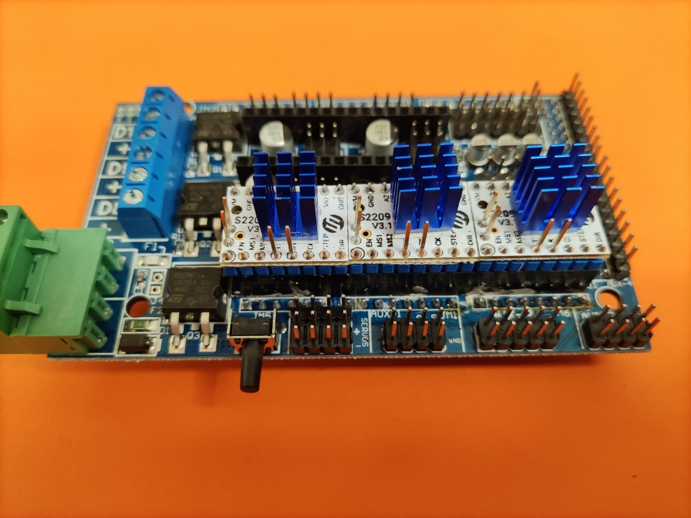
Prepare the electronic
Insert driver board into Arduino shield make sure the polarity is correct (compare writing on both boards)

Slide 28
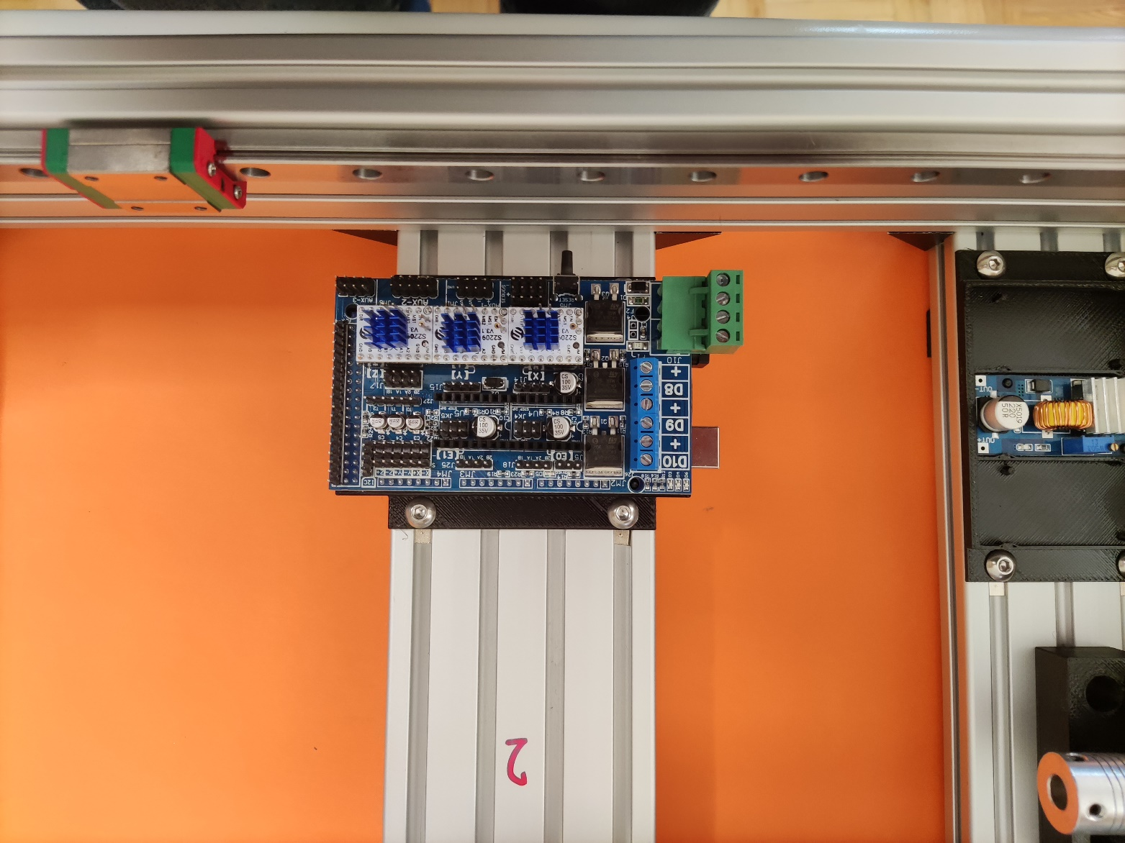
Prepare the electronic
Insert Arduino shield on Arduino and plug in plastic holder

Slide 29
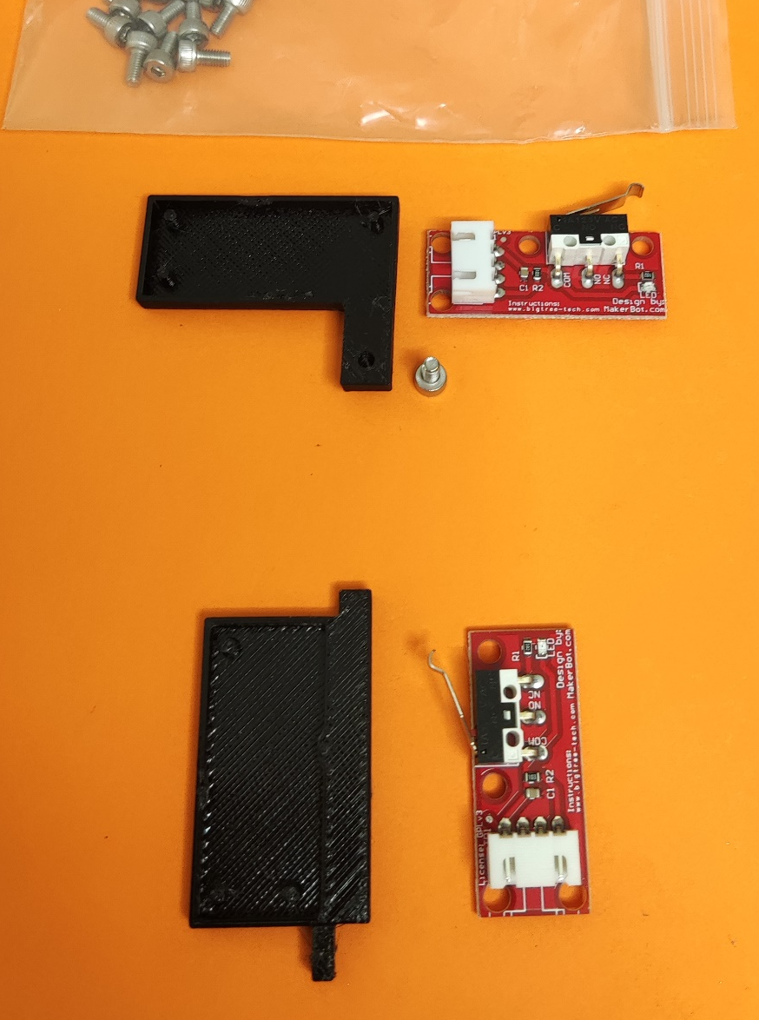
Prepare endswitches
Unpack 2 endswitches and prepare the corresponding printed parts

Slide 30
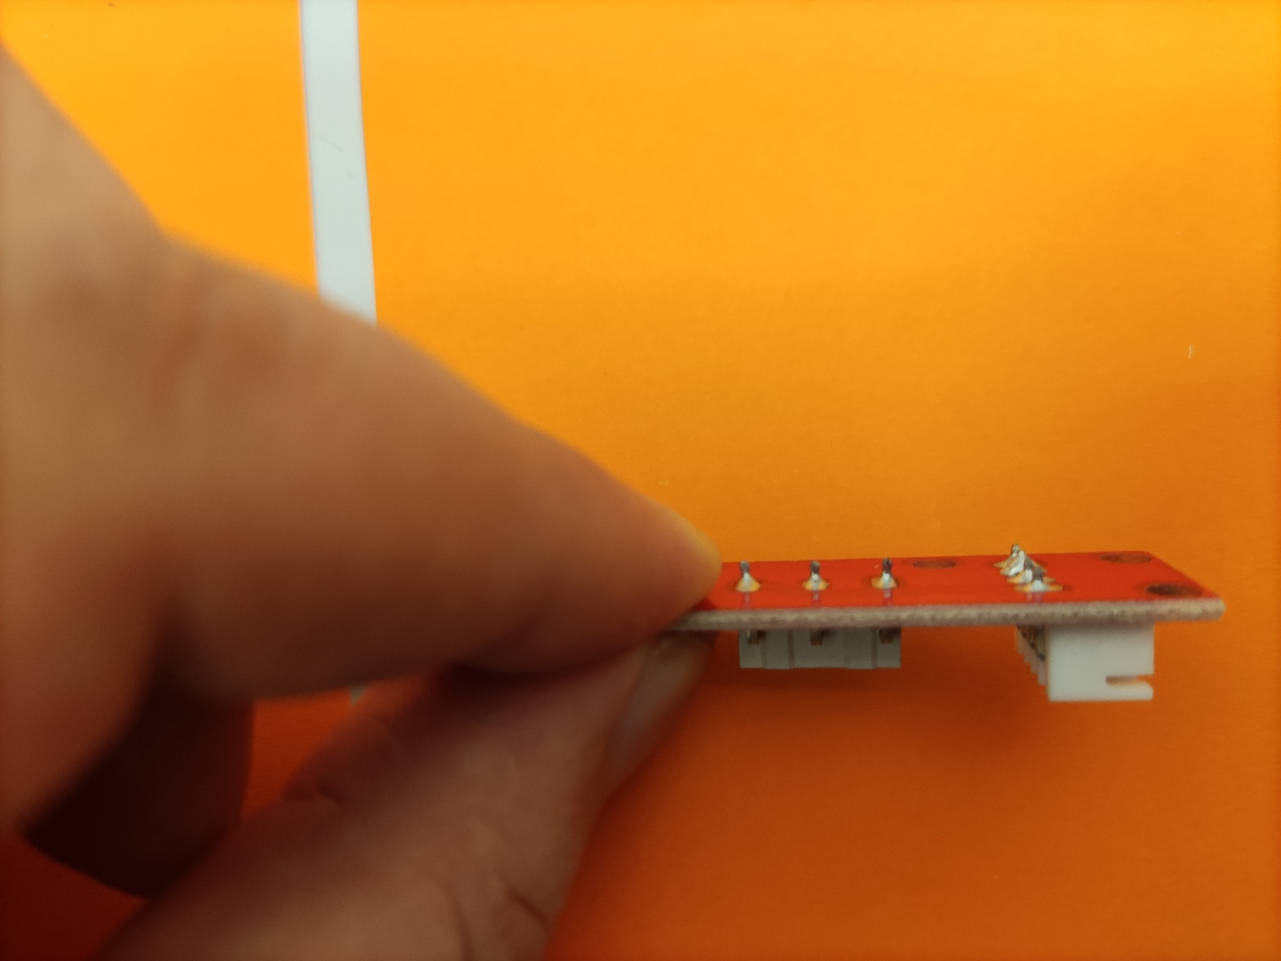
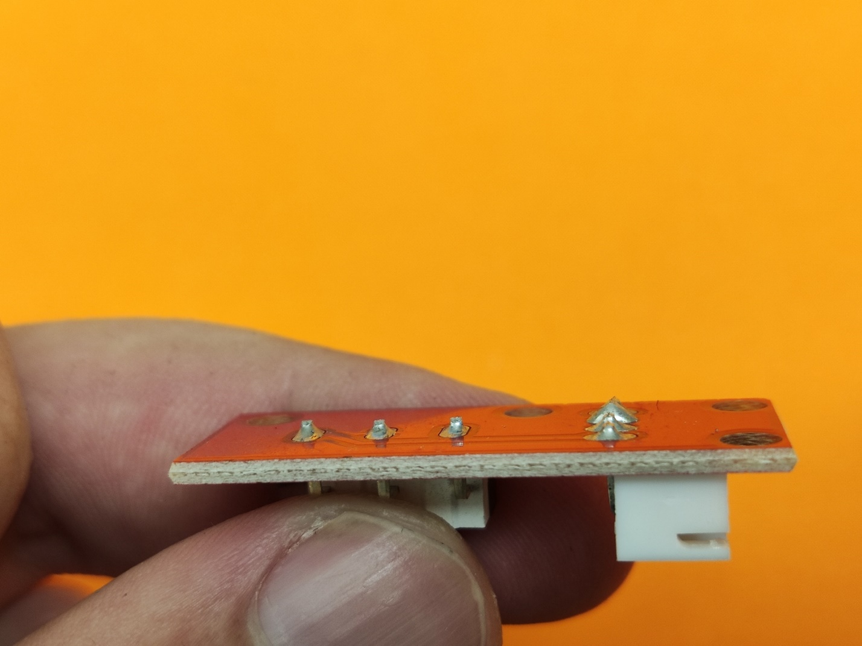
Prepare endswitches
Often the pins are very long and needs to be trimmed down

Slide 31
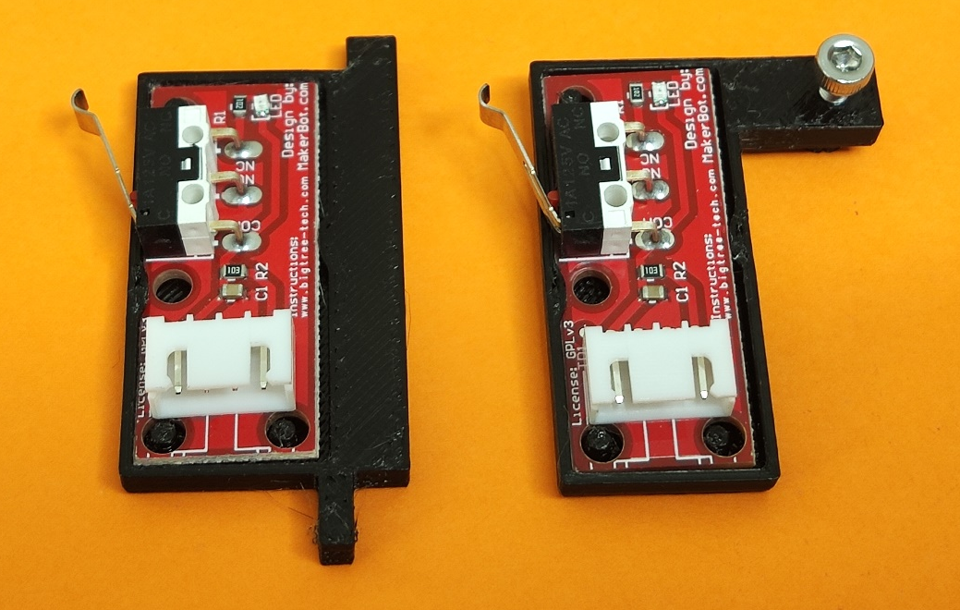
Prepare endswitches
Insert switches into printed parts
insert a M3*8mm screw into the part hole

Slide 32
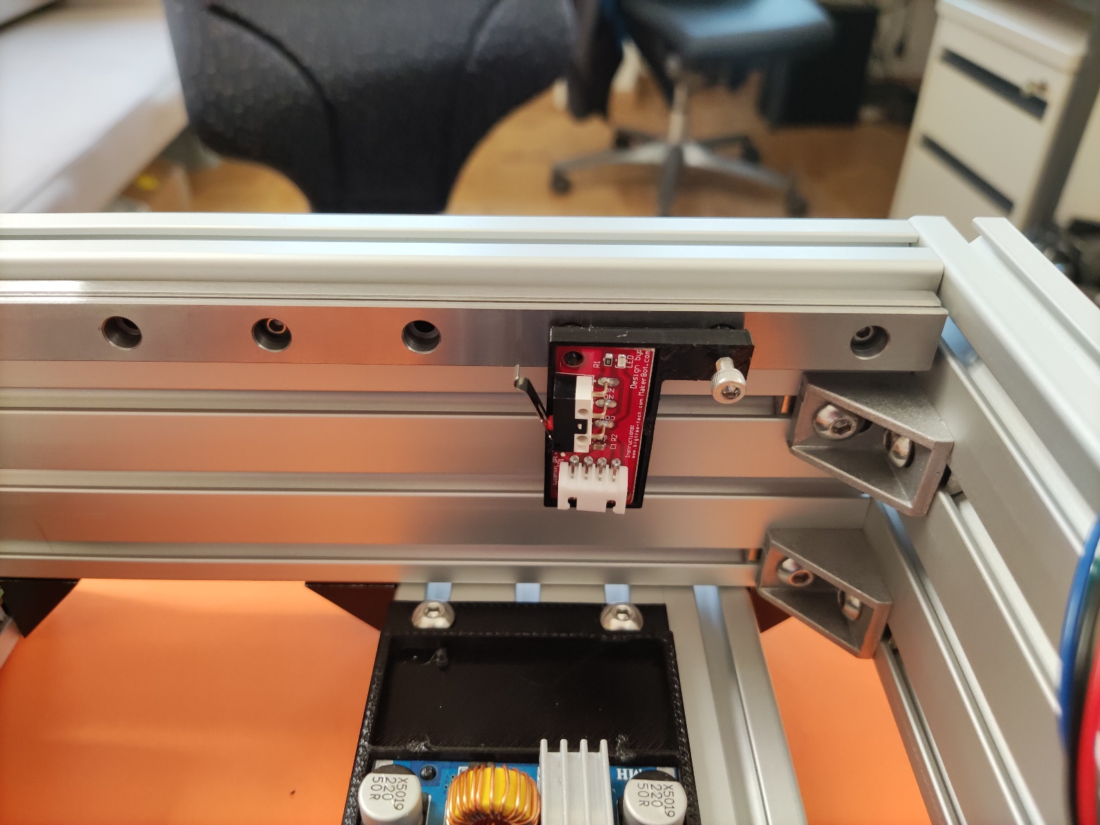
Mount endswitch
Insert endswitch into rail and tighten screw to fasten

Slide 33
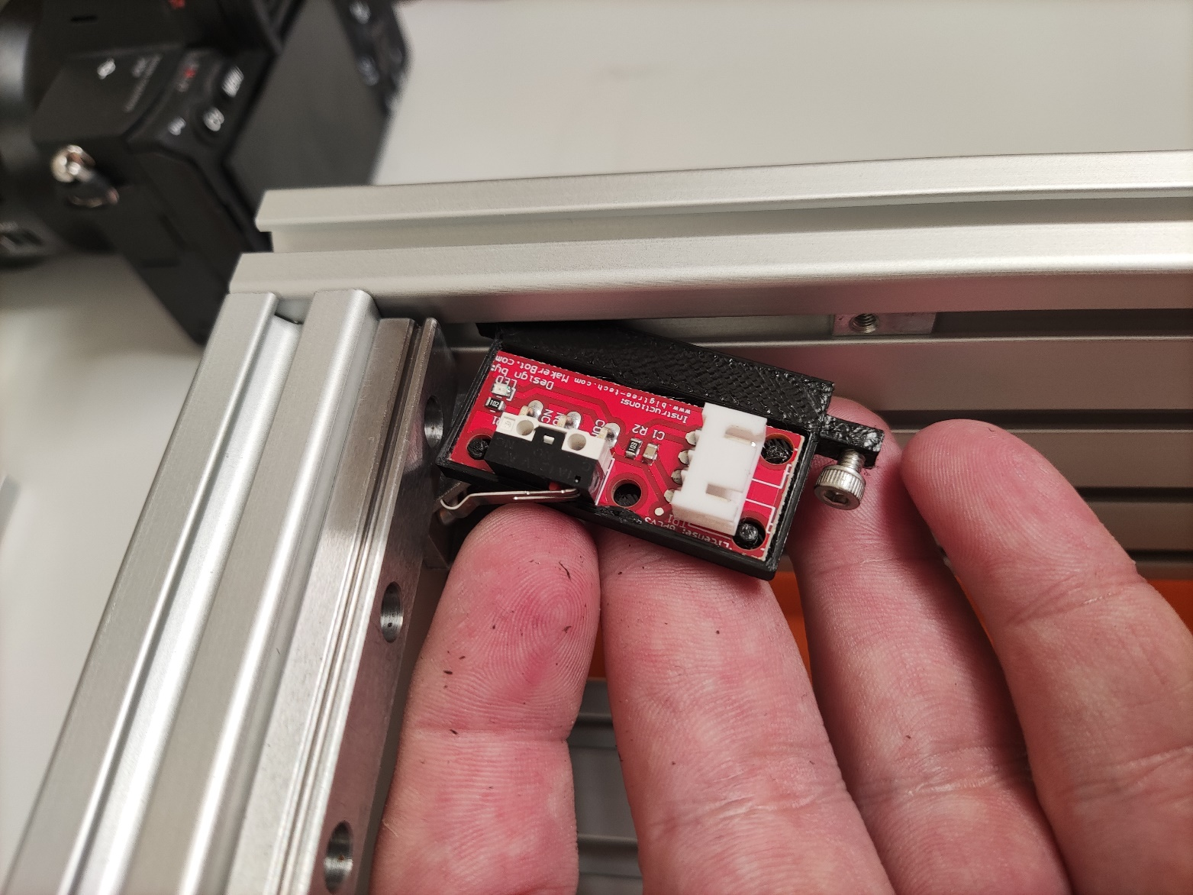
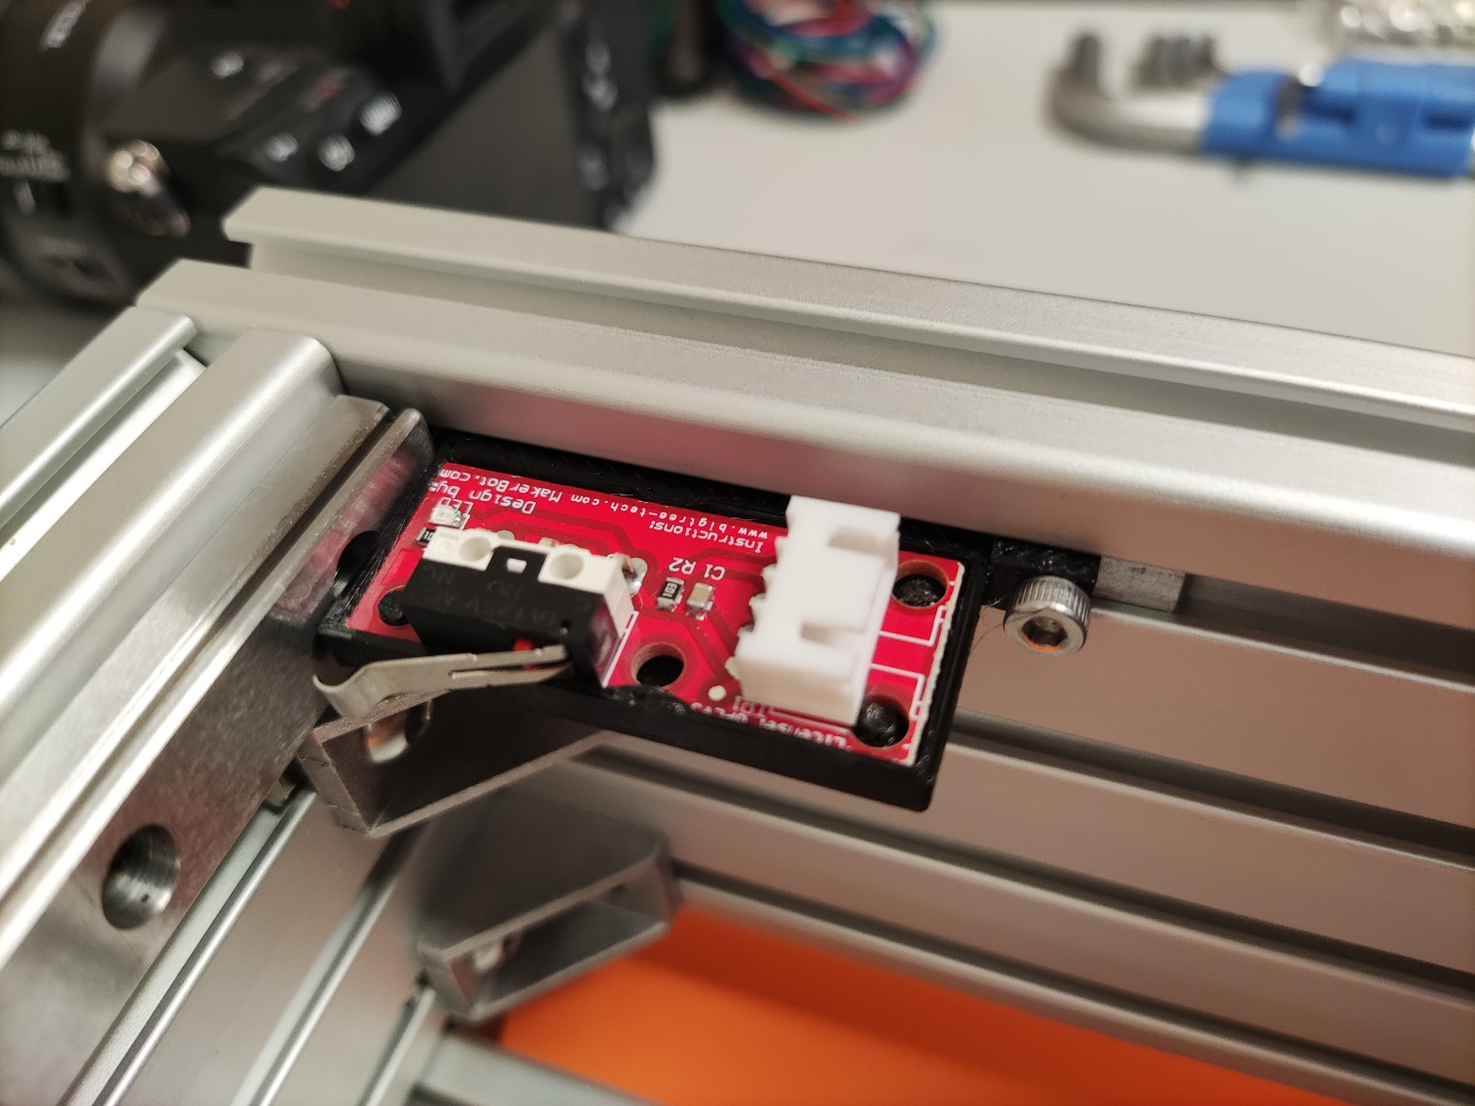
Mount endswitch
Wedge endswitch behind the rail and use a M3*8mm screw to tighten

Slide 34
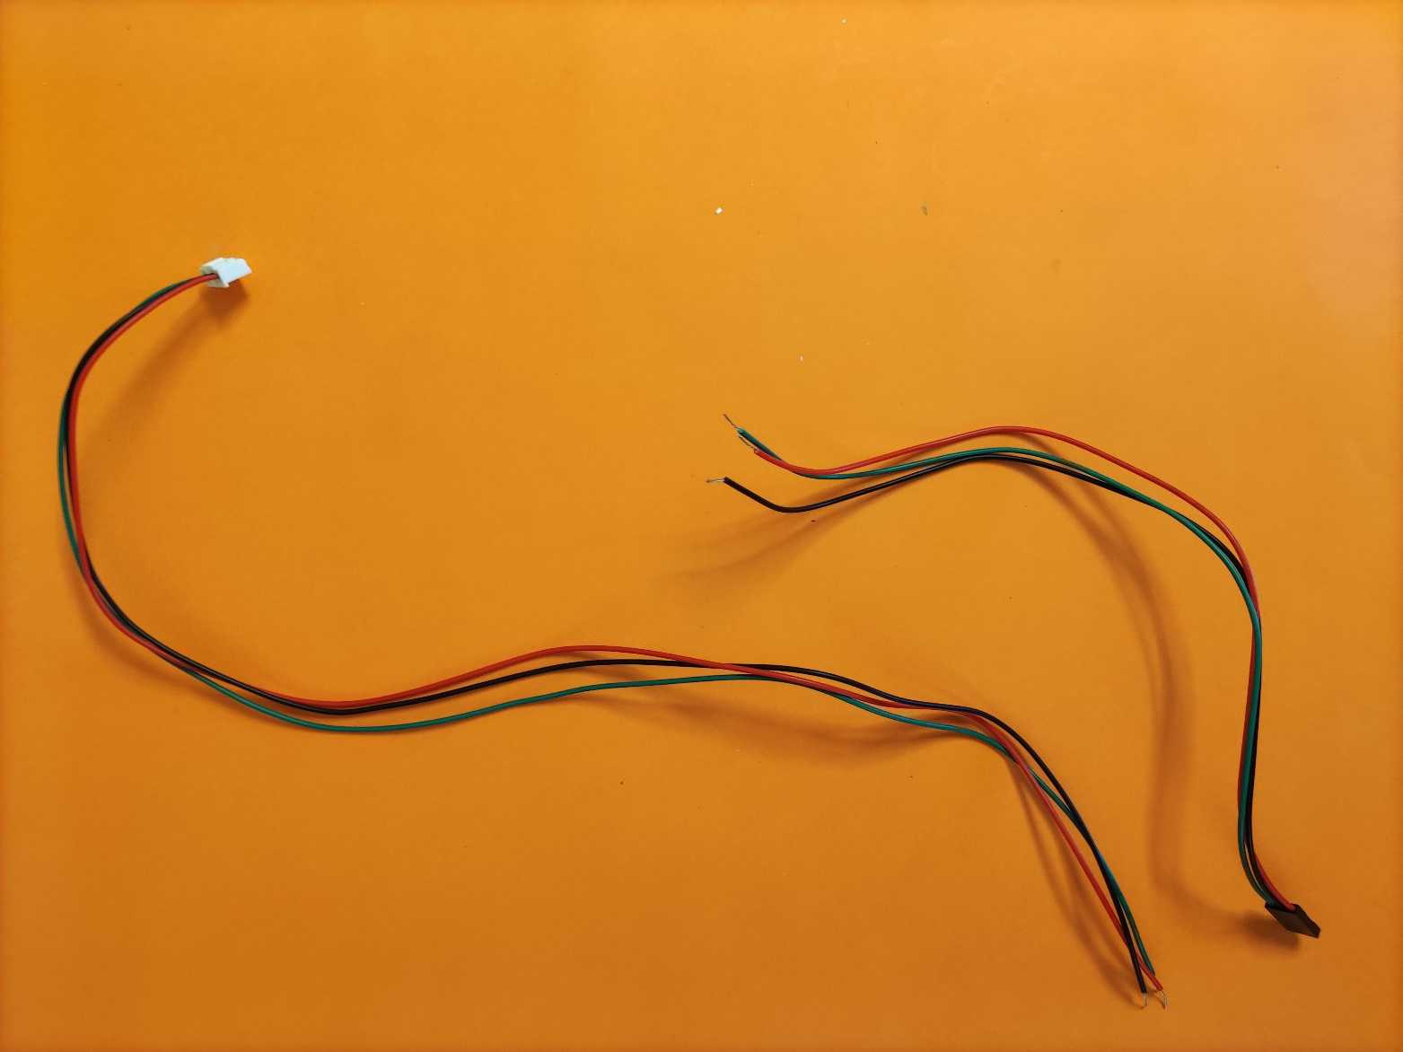
Prepare endswitch cable
Endswitch cable should be 1m long
Cut cable after 43cm from the white plug

Slide 35
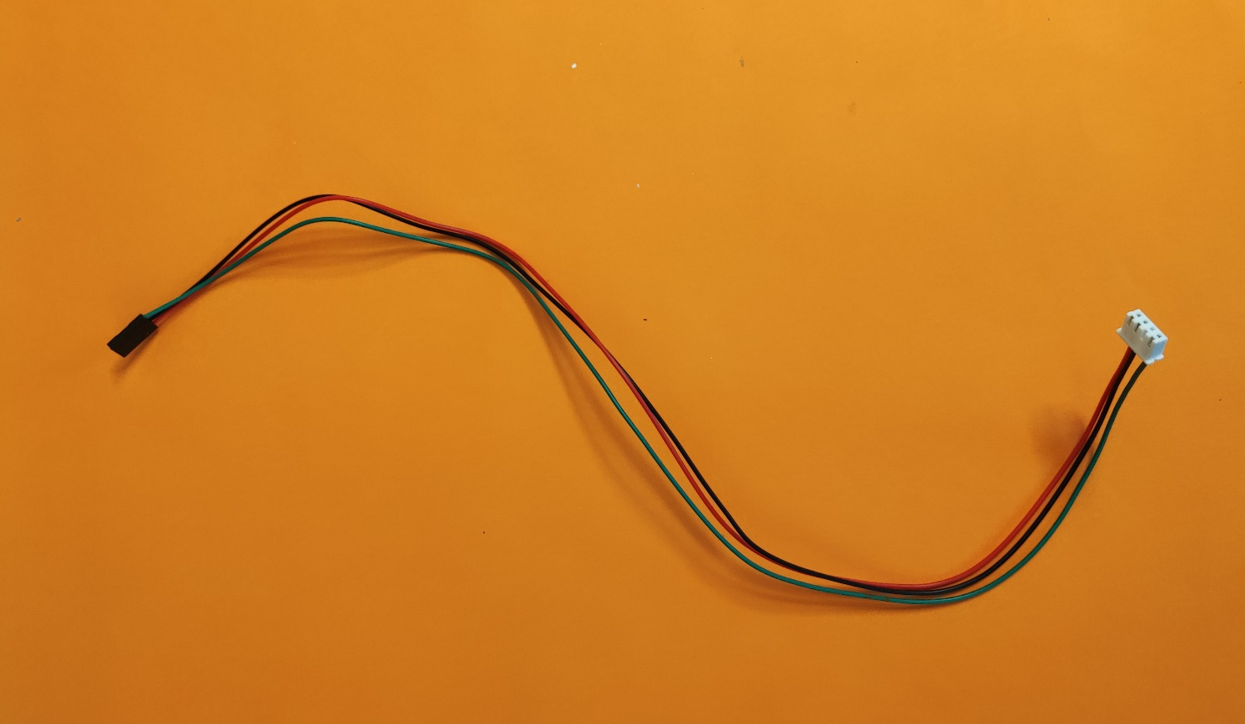
Prepare endswitch cable
Crimp the end of the cable and add dupont plug

Slide 36
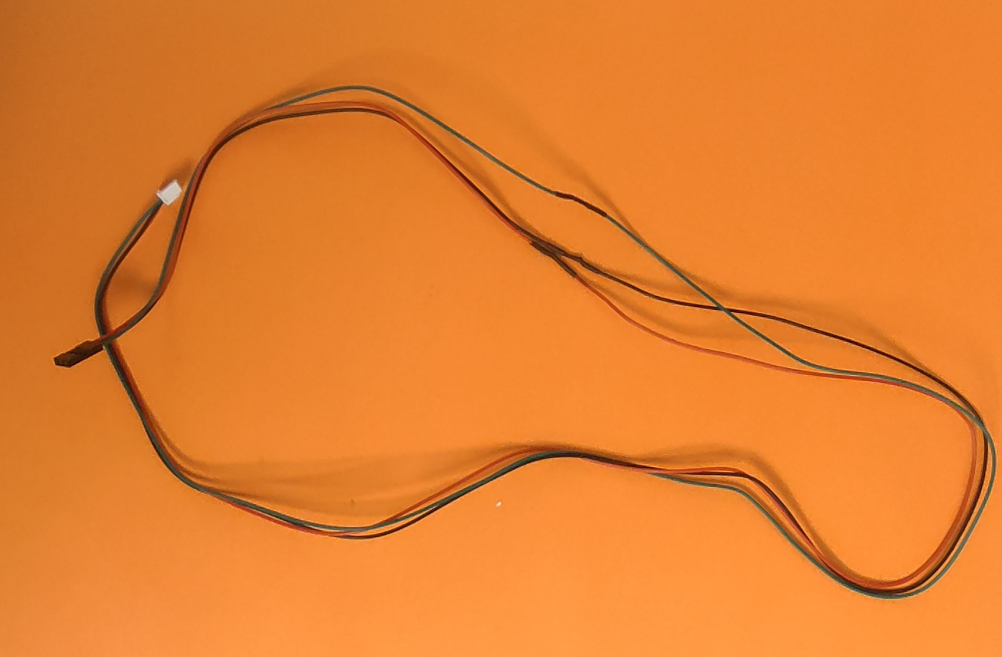
Prepare endswitch cable
Cut the dupont plug from the second cable
Use the short end of the first cable and solder it to second cable.
New combined cable should be aprox. 92cm long

Slide 37
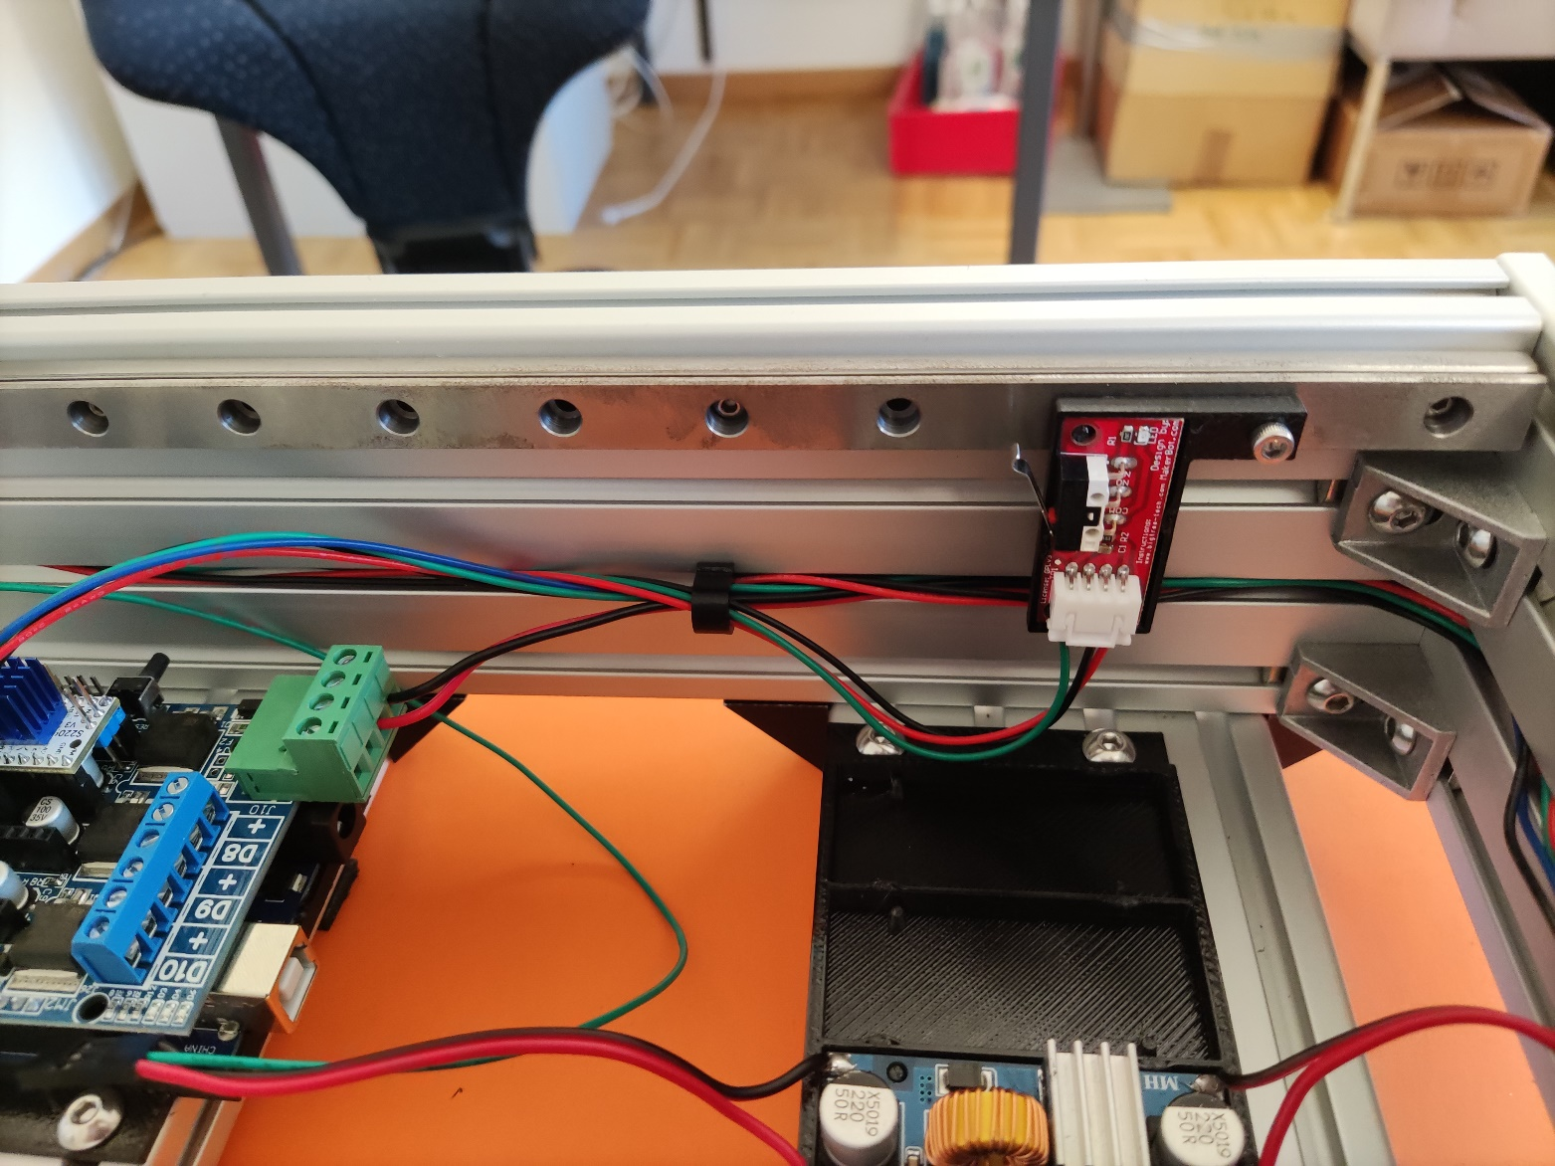
Install power cable
Cut a 48 cm piece of power cable and connect Arduino shield power directly to power supply
Plug in short endswitch cable into endswitch
Cable manage and needed with plastic holder

Slide 38
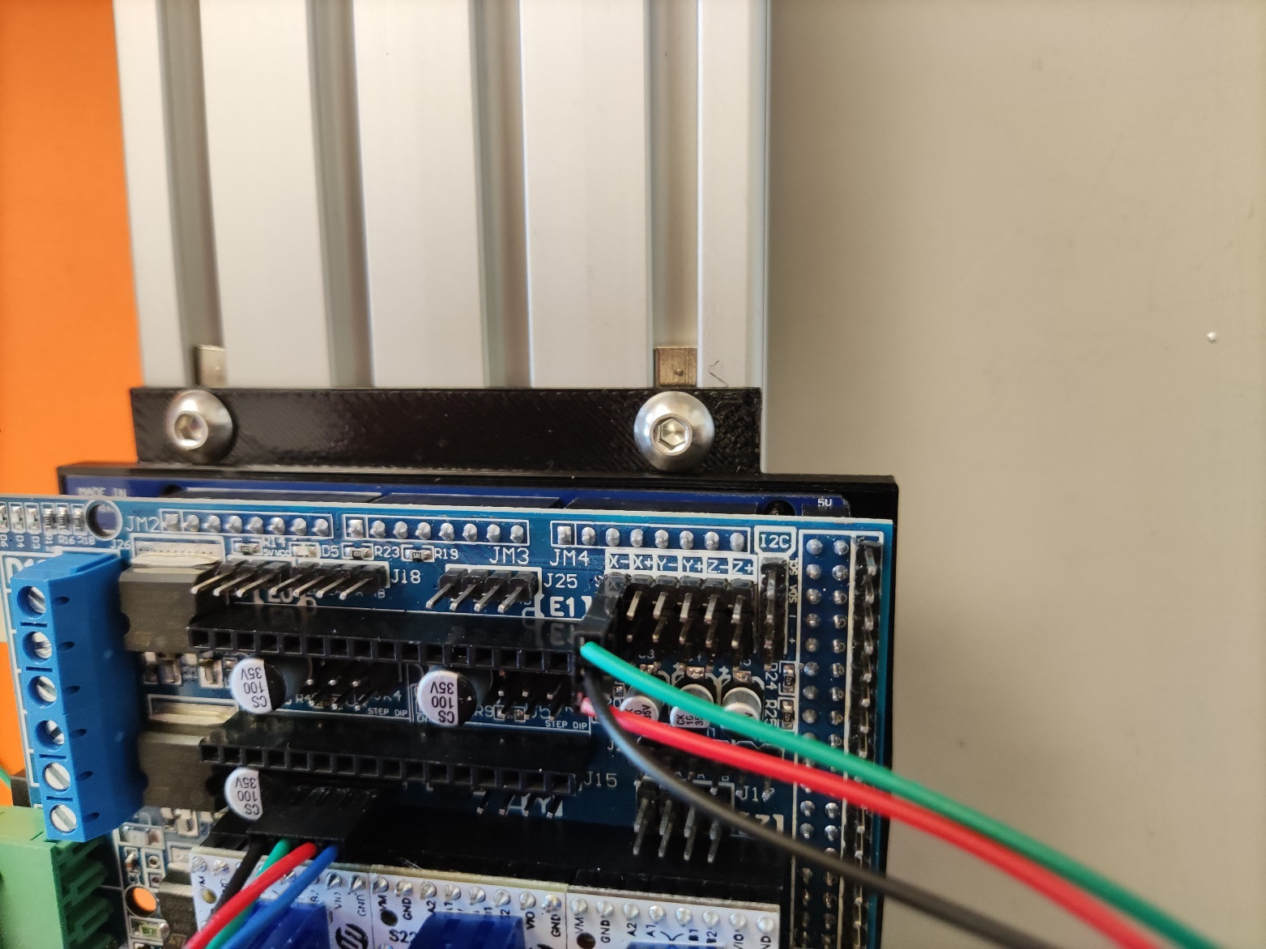
Endswitch
Plug in short endswitch to X- position as shown

Slide 39
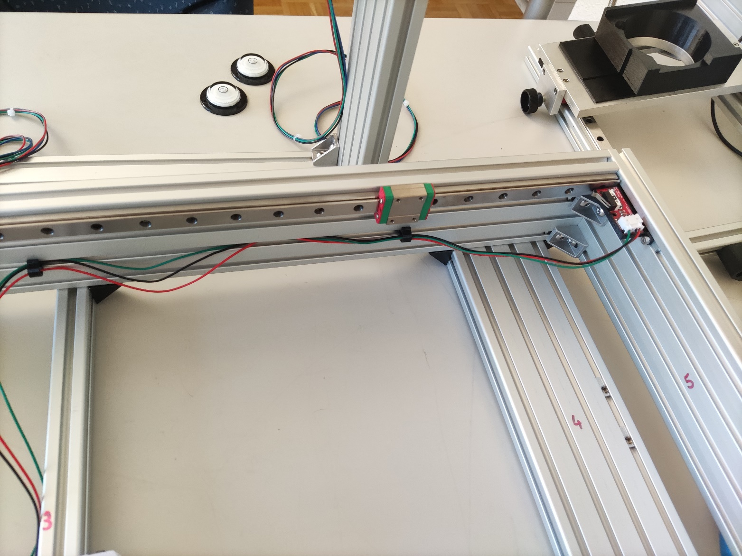
Endswitch
Plug in long endswitch cable into endswitch
Cablemanage as needed

Slide 40
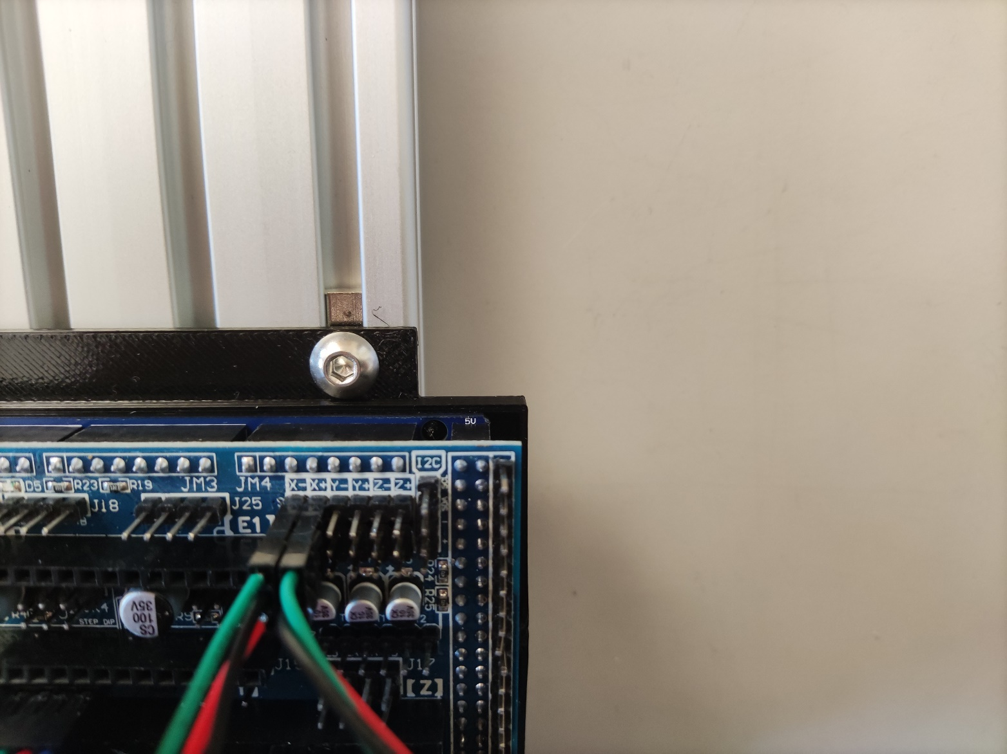
Endswitch
Plug in long endswitch cable into X+ position as shown

Slide 41
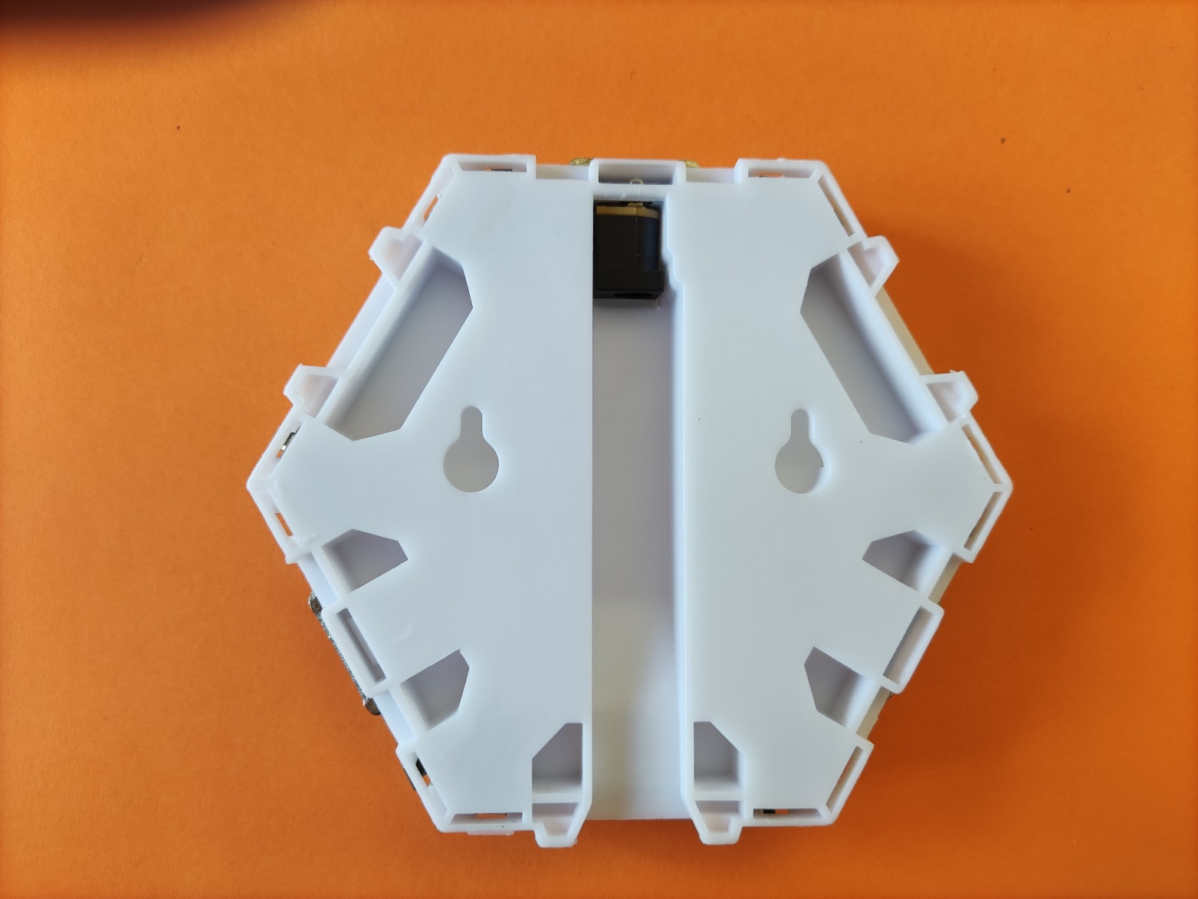
Prepare lamp
Open lamp with a screwdriver by gently pushing plastic flaps

Slide 42
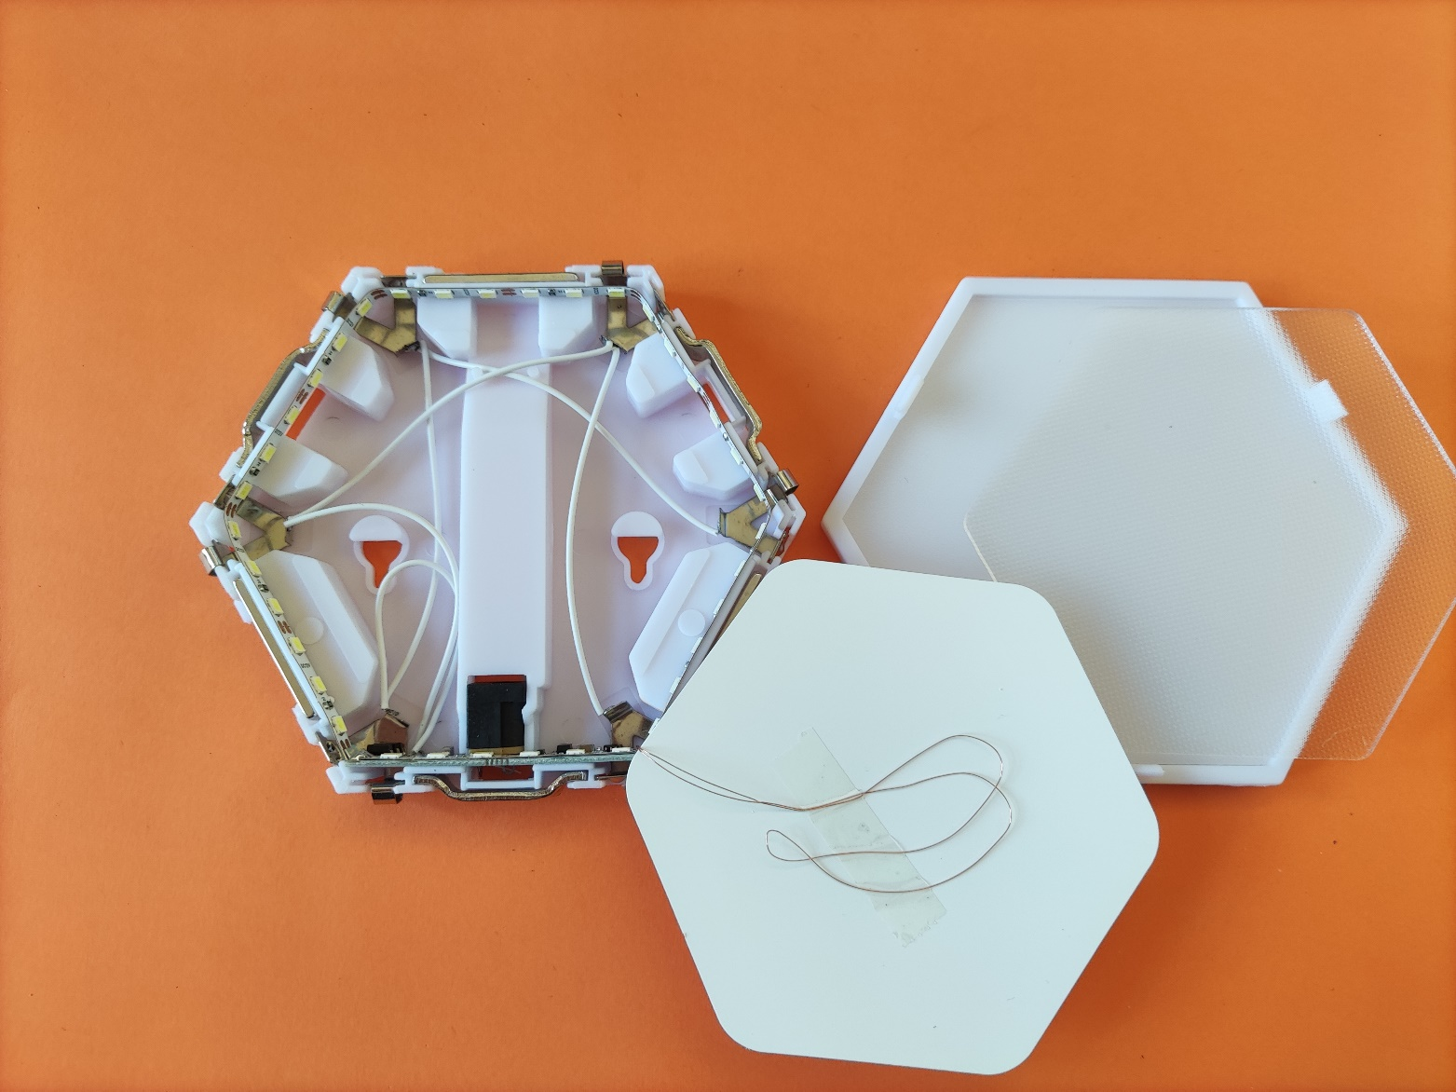
Prepare lamp
When opening it should look similar to the following

Slide 43
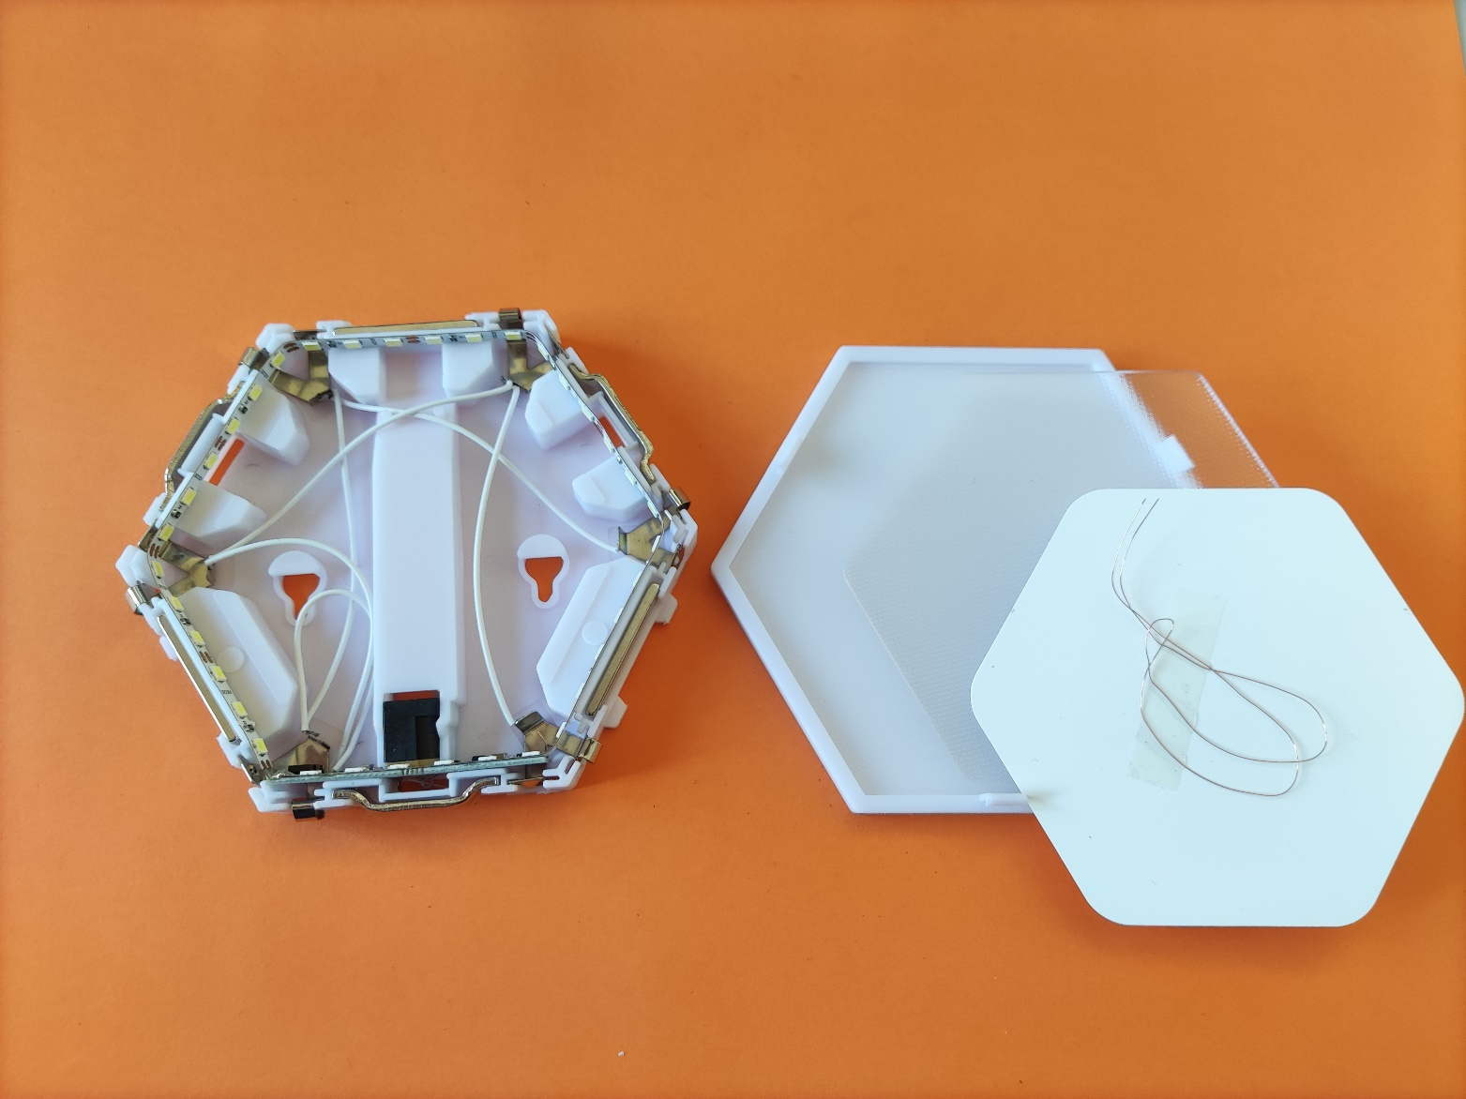
Prepare lamp
Cut the copper sense cable and throw away

Slide 44

Prepare lamp
Cut a 40cm piece of power cable and push it through the screw hole as shown

Slide 45


Prepare lamp
Ignore the electronics and find the connection to the led strip
Solder wire directly to the strip be carefull about the polarity

Slide 46


Prepare lamp
Carefully close lamp back up

Slide 47

Prepare lamp
Add double sided tape or Velcro tape to the bottom of the lamp

Slide 48

Prepare lamp
Glue lamp to the small middle foot

Slide 49

Prepare lamp
Connect the lap power cable to the Arduino shield as shown

Slide 50

Prepare mains power cable
Cut about 1m of mains power cable add local plug to one end

Slide 51

Mains power
Connect mains power cable to power supply
Follow the markings on the power supply as well as your local mains color coding
In this picture browns=phase blue=neutral
Green/yellow =grounding

Slide 52

Power converter
Solder power cable to power converter 30cm on the input and 10cm on the output

Slide 53

Power converter
Insert power converter in plastic holder and connect input directly to the power supply

Slide 54

Power converter
Crimp end of the output cable and add a dupont plug as shown
Cut a 25cm piece of green cable crimp both end and connect as shown

Slide 55

Led control
Plug green cable into the second top pin on the aux-3 connector

Slide 56


X-axis stepper cable
Measure 40 cm from servo cable and cut
Crimp and add new dupont plug

Slide 57

X-axis stepper
Plug in the first stepper driver
With blue cable facing forward ( opposite of what's in the picture. Turning the plug will invert stepper direction)

Slide 58


Prepare X-carriage
Mount two T8 nut (2*8 matching main leadscrew ) into the carriage and screw it slightly with M3*8mm screws

Slide 59

Prepare X-carriage
Make sure the T8 leadscrews can rotate freely and tighten the screws ( adjust T8 nut if necessary)

Slide 60

X-axis endmount
Use printed x axis mount and T8 shaft support as shown
Insert M5*35mm screws into the holes
Note that depending on tolerances (from both pieces) it might be necessary to insert an additional washer between the part to achieve optimal height

Slide 61

X-axis
Insert X-axis into coupler as shown

Slide 62

X-axis
On the other end insert T8 leadscrew into holder and bolt down the M5 screws
Tighten hex screws on both ends (shaft coupler and shaft support)

Slide 63

Prepare arch
Prepare 600mm aluminium profile as follow
All nuts are M5
Add additional M5 nuts at the bottom in every groove (arrows)

Slide 64

Prepare arch
Repeat steps similar to X-axis
Use M3*8mm screws to bolt steppers to plastic and M5*8mm screws to bold plastic to aluminium profile
Distance from start of profile to bottom of plastic 19cm

Slide 65

Prepare arch
Add coupler to each stepper

Slide 66


Prepare arch
Add appropriate reinforcement plastic part at the bottom of the stepper (L & R are mirrored and not identical)

Slide 67


Prepare arch
Slide plastic slider on both edges of the profile you just prepared
Note the added dupont plug to make the arch fully removable (more details later)

Slide 68

Prepare arch top
Prepare 350mm aluminium profile as shown with 4 metallic connectors (+M5 nuts and screws)

Slide 69

Arch
Assemble arch with M5*8mm screws

Slide 70
Arch
Fasten arch to base frame as shown with 4 M5*8mm screws
Arch should be 40 cm from starting edge ( electronic side)

Slide 71

Cables
This is how the whole assembly should look so far
To avoid having too much cable everywhere cut to length (74 cm left servo 47cm right servo) and redo the plug similar to X-axis
To make it more modular consider cutting the cable at 23cm on both side (until bottom) and add a dupont connection make connector cable with dupont plugs on both sides 25 and 52 cm long
with this arrangement the arch can be unplugged at the base and removed if needed

Slide 72

cables
Cable manage as necessary using plastic clips and zip ties
Plug in servo cable in second and third stepper driver (order does not matter)

Slide 73

Metal angles
Screw metal angles into the rail carriages with 8 M3*8mm screws on each side

Slide 74

Table
Add metal table and bolt down with appropriate screws (short screws on the outside long screws in the middle connecting to the x-axis)

Slide 75

Prepare Camera assembly
Prepare all the required pieces as shown

Slide 76





Assemble z axis
Use printed z axis holder (similar to depicted) with one bronze T8 nut and 4 M3*20mm screw and corresponding M3 lock nut
Do this once for each side

Slide 77

Camera frame
Add 4 M5 nuts in a 90° angle (only one depicted in what will be the bottom but should be 2)
Do this 2 times

Slide 78

Camera frame
Copy nut configuration
Note that the 5 inner nuts are M3 nuts
Do this 2 times

Slide 79


Camera frame
Assemble with metallic connectors and M5*8mm screws as follow

Slide 80

Camera frame
Mount rails to camera frame assembly similar to main frame (M3*8mm screws)
Add rails stopper to both ends of rail

Slide 81

Camera frame
Camera frame with rails and railstops mounted

Slide 82

Z-axis
Add z axis holder (similar to picture) and fasten to bottom of frame with 2 M5*8mm screws each

Slide 83

Z-axis
Add 20cm T8 leadscrew

Slide 84

Camera holder
Fasten the camera metal base to the camera frame carriage with 4 M3*8mm screws on each side

Slide 85

Camera holder
Add camera knob on the side as depicted

Slide 86

Camera holder
Use double sides tape or screws to fasten 3d printed holder onto metal base

Slide 87


Z-axis
Prepare the end of the Z-axis very similar to end of X axis but with different spacer and M5*16mm screws

Slide 88


Z-axis
Make sure T8 leadscrew sticks out about 3-4 cm and put the whole assembly into the arch steppers

Slide 89


Z-axis
Add the end of the Z-axis on both side
Fasten hex screws then tilt the ends vigorously to match the aluminium profile grooves width and fasten down the screws

Slide 90

Z-axis
Fasten hex screw on coupler as well

Slide 91

Prepare LED ring
Insert objektiv filter into the printed diffusion ring
Push down with some force so as to wedge the ring in the printed part
Make sure the thread of the filter is on the upper part sicking out of the part (as shown)

Slide 92



Prepare LED ring
Separate the outer two LED rings from the rest

Slide 93


Prepare LED ring
Strip about 2cm of the wires and tin them
Use the green wire to bridge DO and DI (Digital Out of the first ring into Digital In of the second ring)
Cut of left of green wire
Solder red and white wired on 5v and GND respectively
Solder leftover green wire on DI
Crimp dupont on the other end of the wire after aprox 10 cm

Slide 94

Prepare LED ring
Insert Led ring firmly into printed diffusion ring

Slide 95
Adjust power
DO NOT connect the Led ring yet!!!!!
Plug in power supply
While powered adjust output voltage to 5v by turning the small screw

Slide 96


Upload firmware
Connect Arduino to computer
In Arduino studio find the right port and flash firmware onto arduino

Slide 97
Plug in LED cable
Make a 1m cable of the same wire that you used for the LED ring and add dupont plugs on both ends
connect cable to power module and led ring

Slide 98
Test everything
Connect skippy to power and computer
Start control software
Make sure all axis work fine
Make sure the endstops light up when pressed and work to stop X-axis when pressed
Makes sure both lightsources work
lubricate X and Z axis well with oil or grease (NO WD40!! WD40 is not a lubricant it’s a rust remover and will over time damage the leadscrews and nuts)

Slide 99
DONE!
Congrats your successfully finished your skippy!!

